Slide 1

翰林國中英語
教學 PPT (課本)

Slide 2

Warm-up
Grammar Focus 2
Dialogue
Reading
Theme Words 1
Sounds and Letters
Grammar Focus 1
Exercise
Theme Words 2
Vocabulary

Slide 3
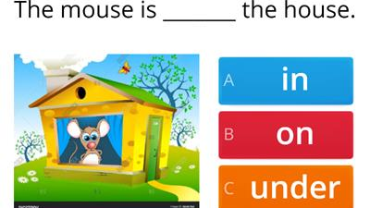

Slide 4
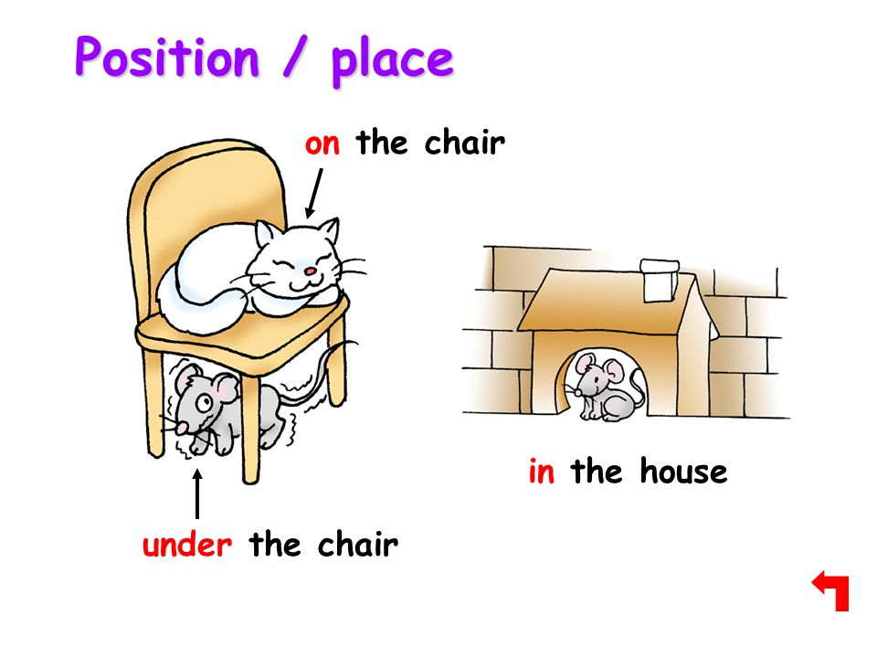

Slide 5
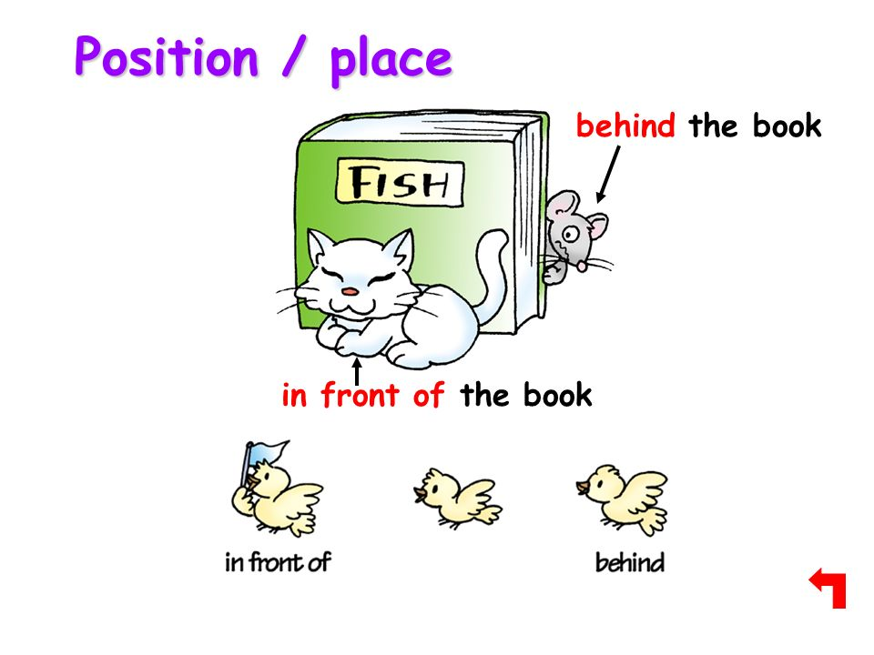

Slide 6
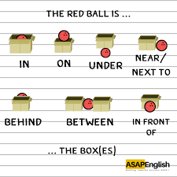
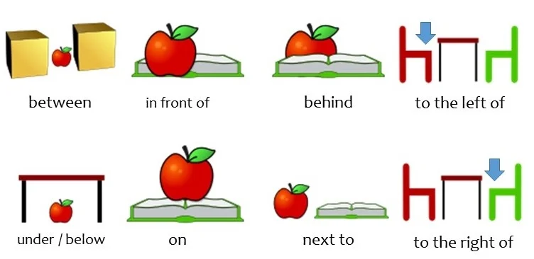

Slide 7


Slide 8
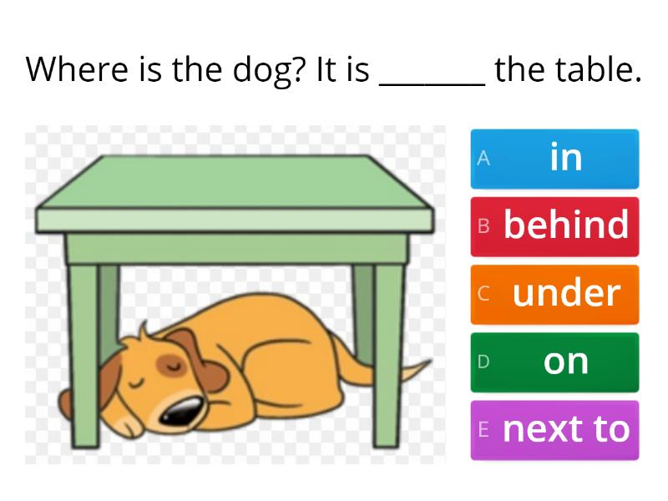

Slide 9


Slide 10
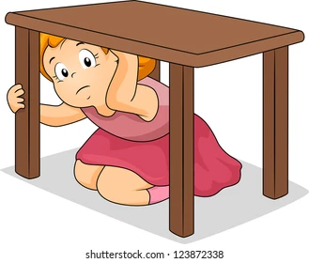

Slide 11
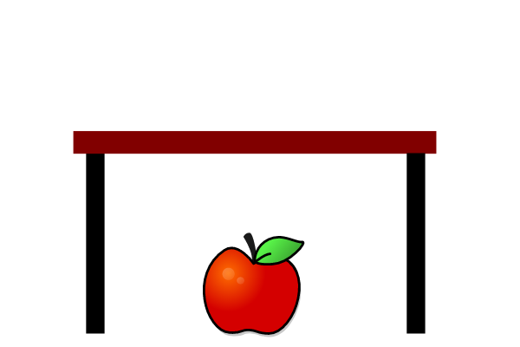

Slide 12
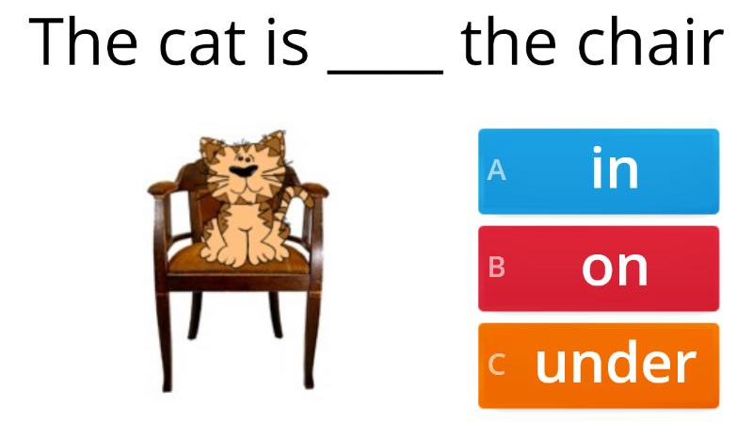

Slide 13
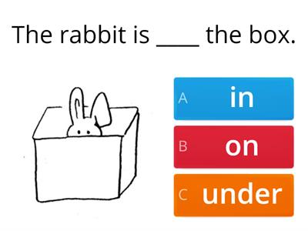

Slide 14
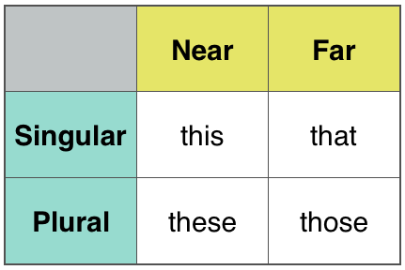

Slide 15
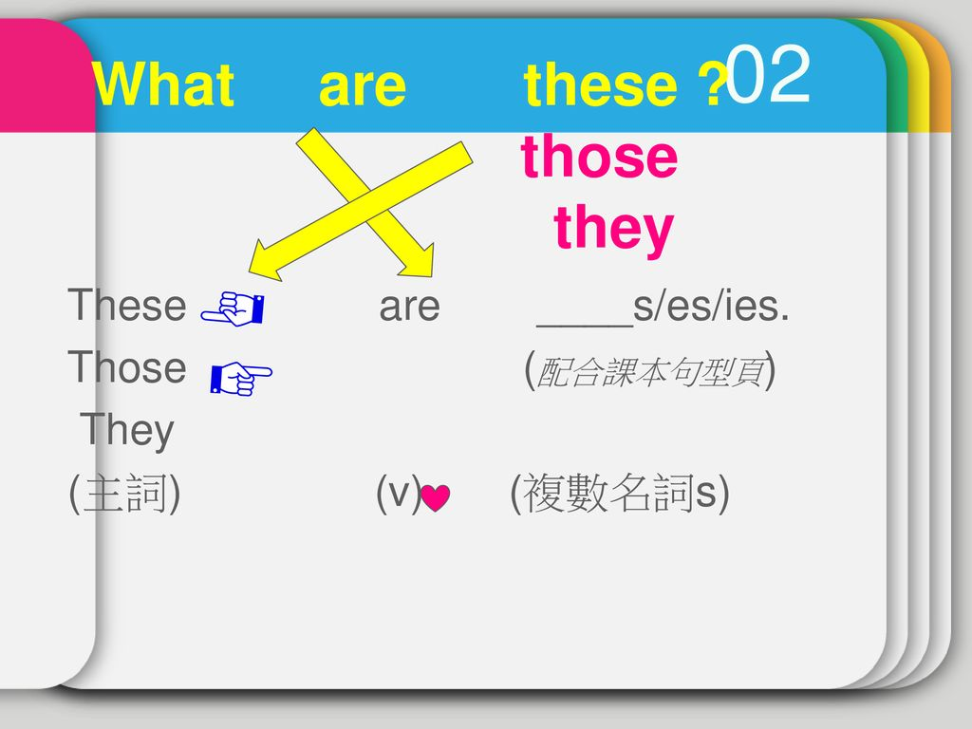

Slide 16


Slide 17
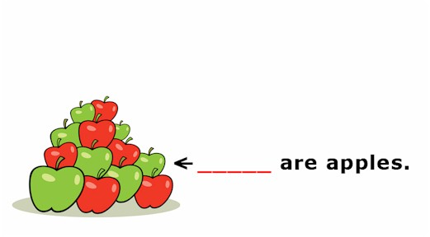

Slide 18











Slide 19
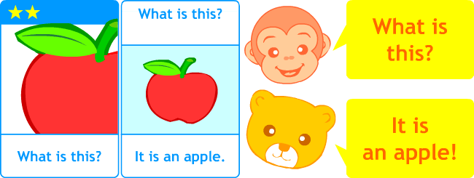

Slide 20
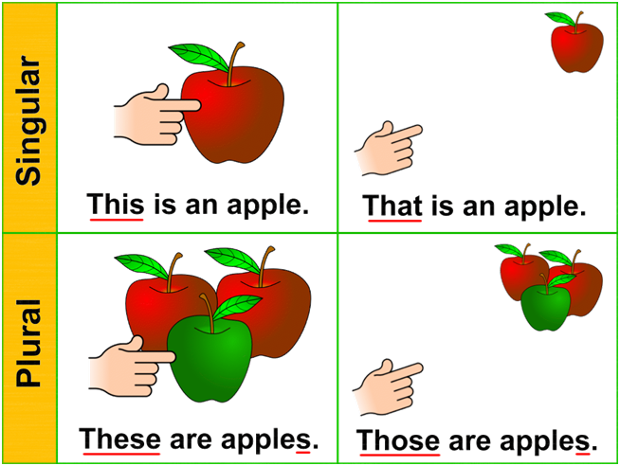

Slide 21
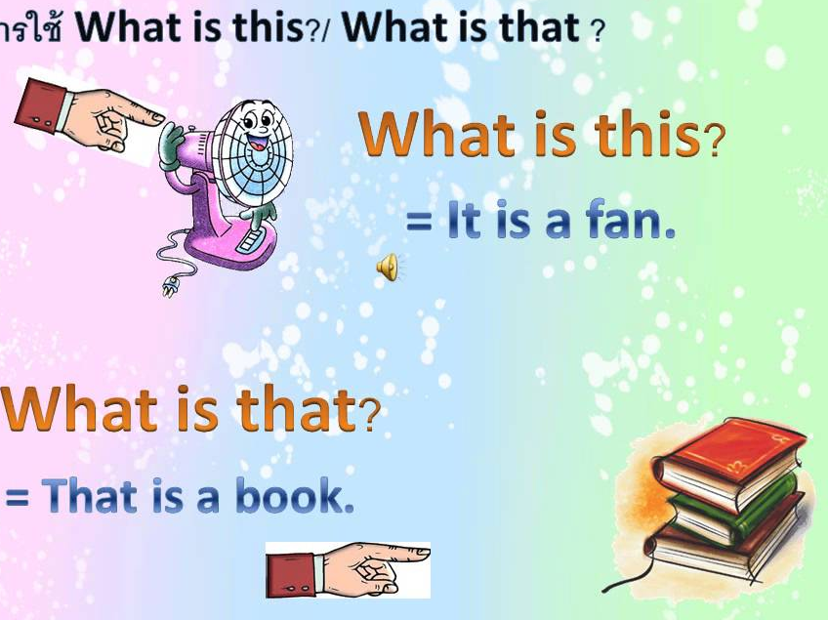

Slide 22
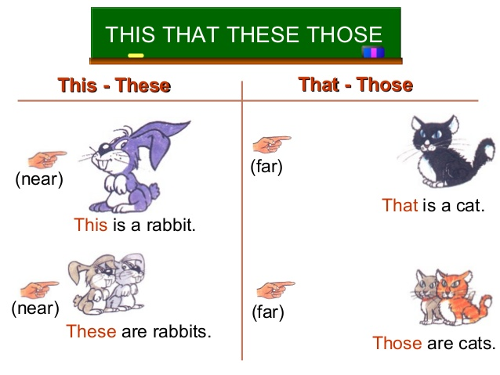

Slide 23
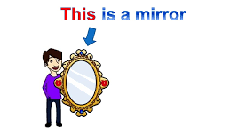

Slide 24
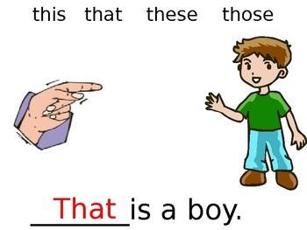

Slide 25
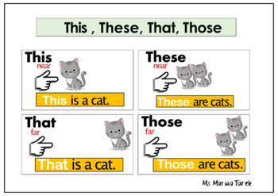

Slide 26
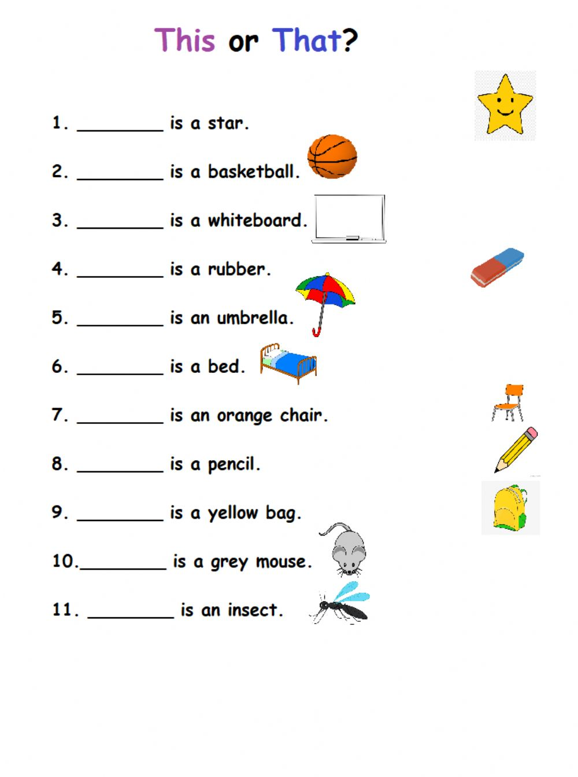

Slide 27
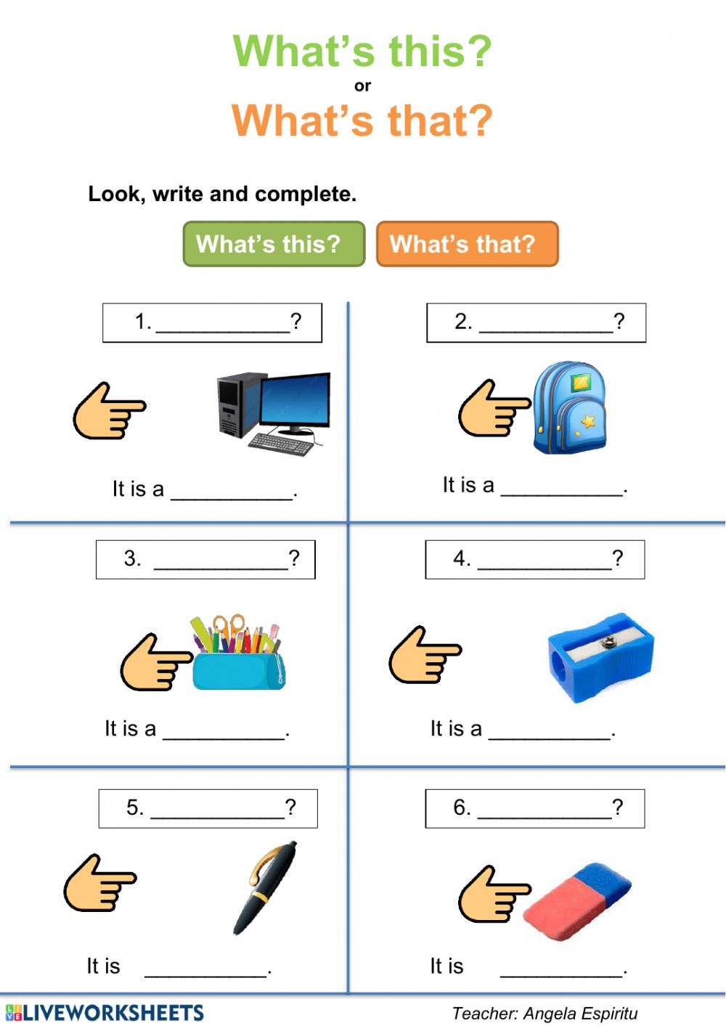

Slide 28
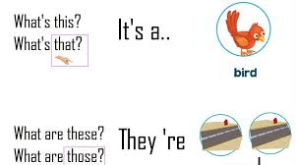

Slide 29
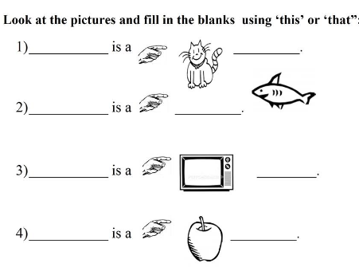

Slide 30
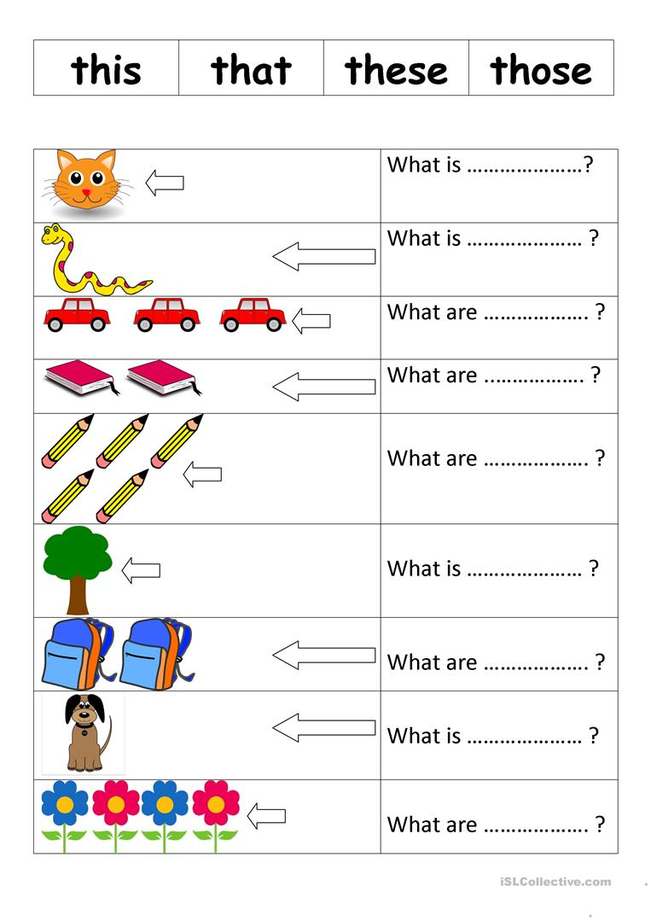

Slide 31
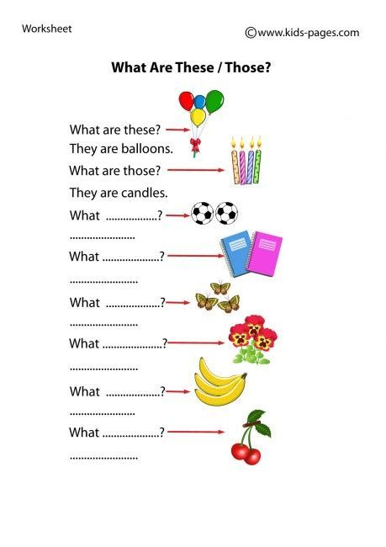

Slide 32

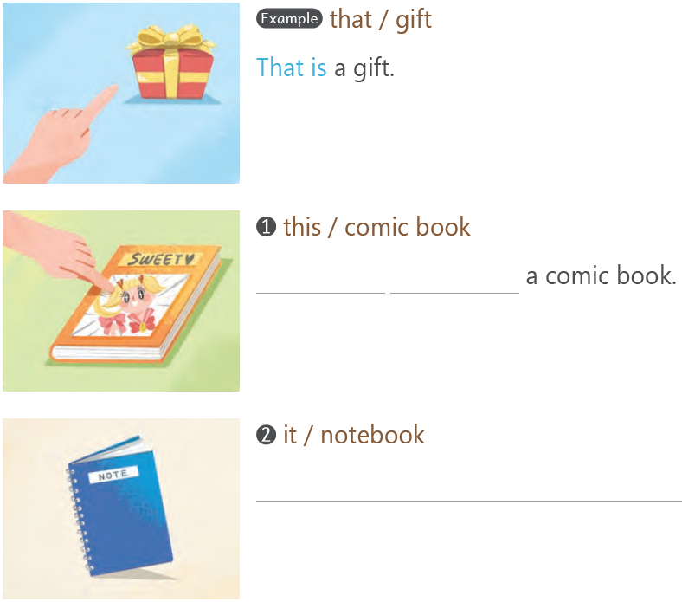

This
is
It is a notebook.

Slide 33
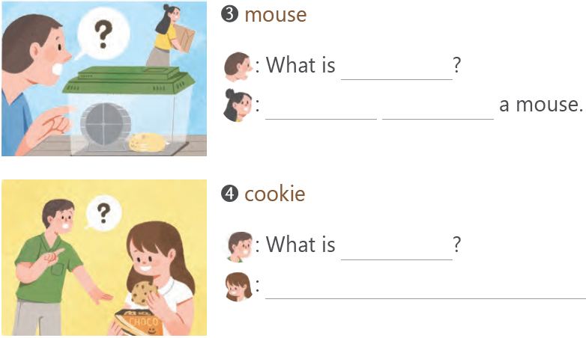
this
That
is
that
This is a cookie.

Slide 34



Slide 35

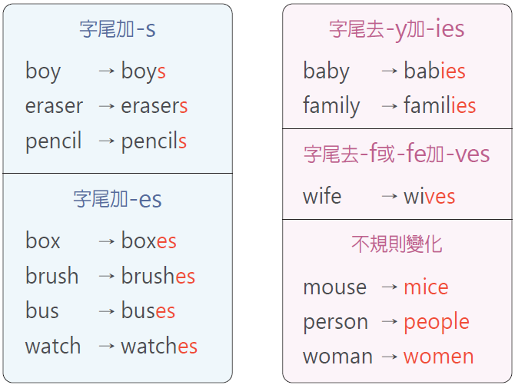
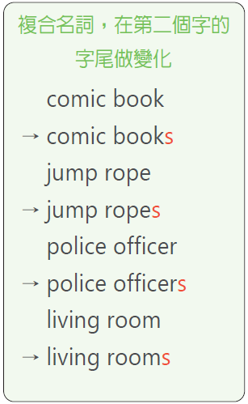

Slide 36
1. bed 2. wall
3. house 4. watch
5. housewife
6. school bus
7. pencil box
8. comic book
beds
walls
houses
watches
housewives
school buses
pencil boxes
comic books

Slide 37



Slide 38

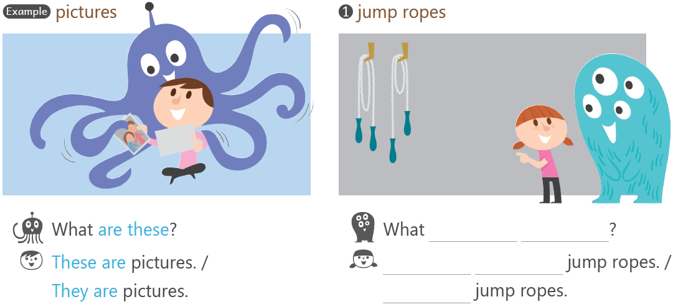
are
those
Those
are
They're

Slide 39
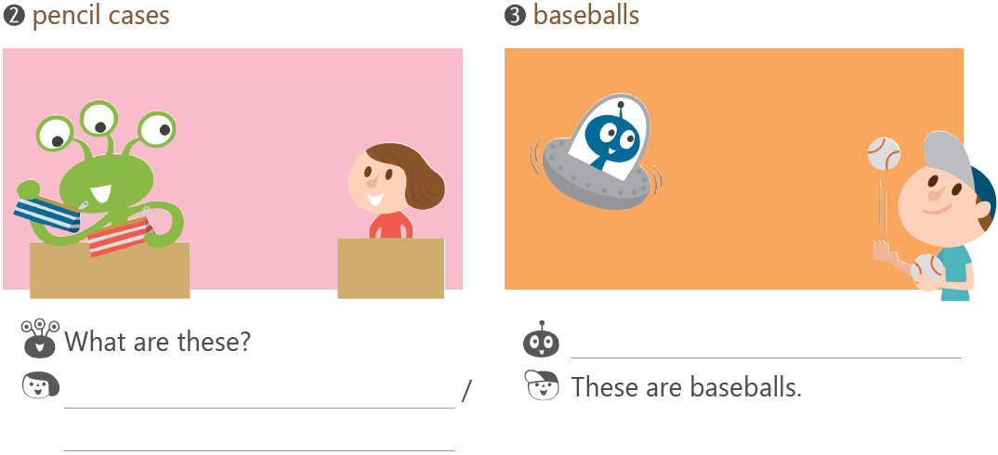
What are those?
Those are pencil cases.
They're pencil cases.

Slide 40



Slide 41




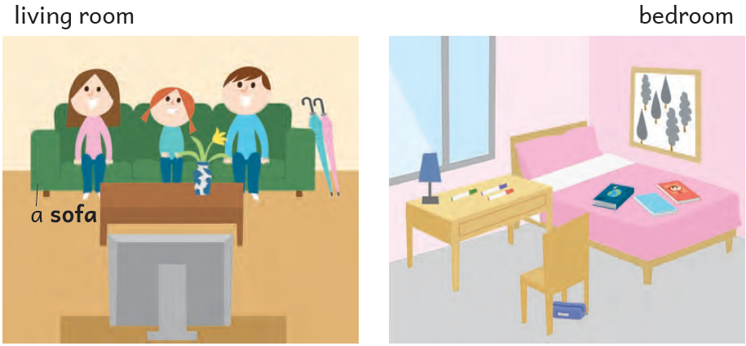

Slide 42

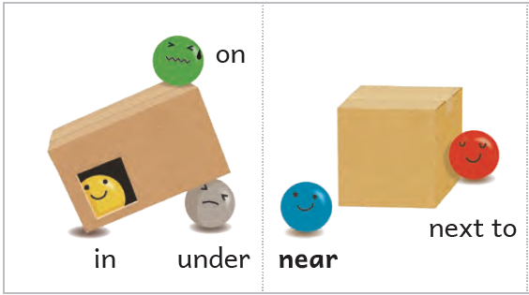


Slide 43




Slide 44

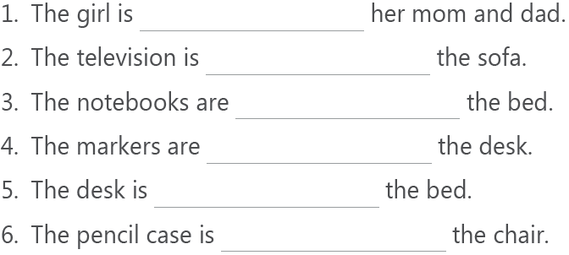
between
in front of
on
on
next to
under

Slide 45
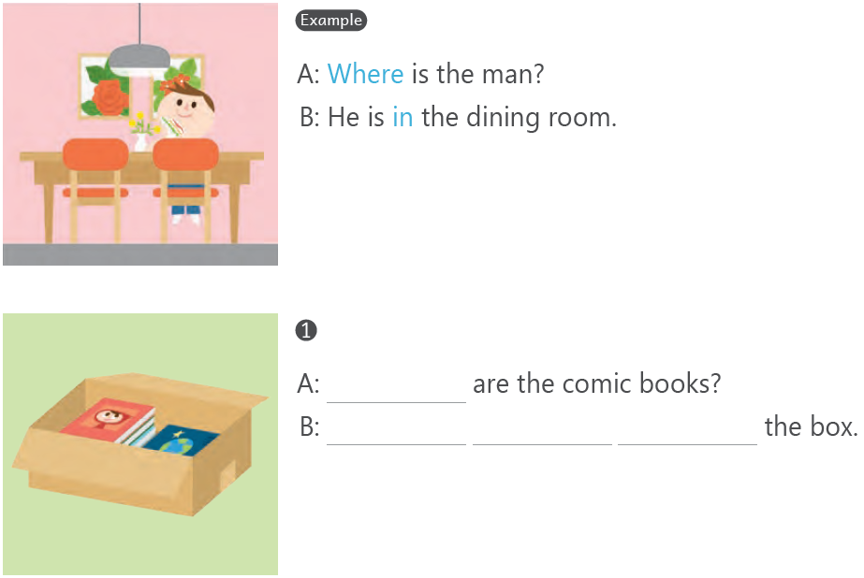
Where
They
are
in

Slide 46
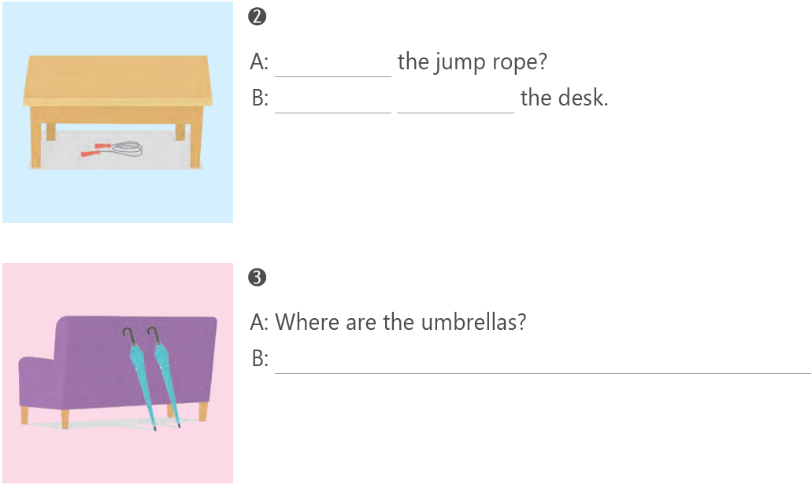
Where's
It's
under
They're behind the sofa.

Slide 47

Where's the blue pen?

