Slide 1
Unit 5 What’s the Date?
單字補充

Slide 2
1. date [det] n.日期
【例】What’s _______ _______ today?
(今天是幾月幾日？)
the
date

Slide 3
2. November [noˈvɛmbɚ] n. 十一月
【例】_____________ is the last month of fall.
(十一月是秋天的最後一個月。)
November

Slide 4
3. first [fɝst] adj.; adv.; n. 第一（的）
【例】Sunday is ______ _______ day of the week.
(星期日是一週的第一天。)
【例】My grandmother get up first every day.
(我的外婆每天都第一個起床。)
the
first

Slide 5
4. Thanksgiving [͵θæŋksˋgɪvɪŋ] n. 感恩節
【例】American usually get together with their family and have a big meal on ____________.
(美國人通常在感恩節與家人團聚並且一起享用大餐。)
Thanksgiving

Slide 6
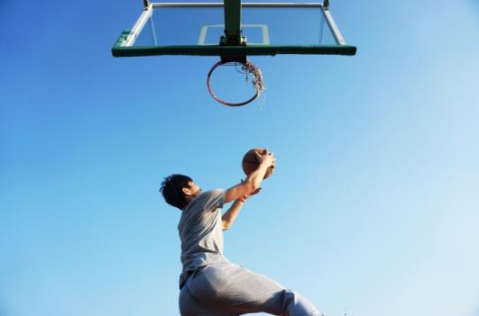
5. important [ɪmˋpɔrtn̩t] adj. 重要的
【例】Basketball is __________ ____ Jesse.
(籃球對 Jesse 而言很重要。)
important
to

Slide 7
6. holiday [ˋhɑlə͵de] n. 節日；假日
【例】____________ is a _________ in the USA,
not in Taiwan.
(感恩節在美國是假日，在台灣不是。)
Thanksgiving
holiday

Slide 8
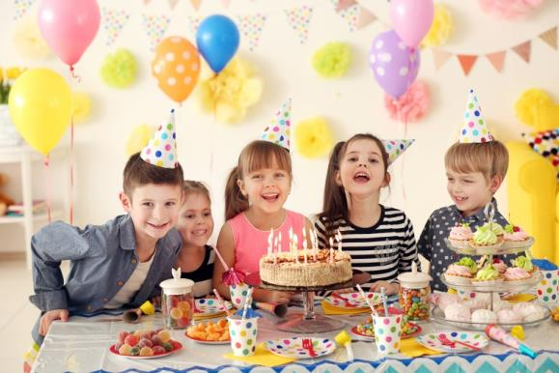
7. when [(h)wɛn] adv. 何時
【例】Judy: ________ is your birthday party?
Jesse: _______ this Saturday.
(Judy：你的生日派對是何時？
Jesse：這星期六。)
When
It’s

Slide 9
8. fourth [fɔrθ] adj.; adv.; n. 第四（的）
【例】_______ ________ class today is art.
(我今天的第四節課是美術。)
【例】Children’s Day is on April ________.
(兒童節是在四月四號。)
My
fourth
fourth

Slide 10
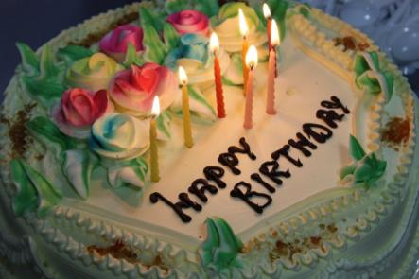
9. birthday [ˋbɝθ͵de] n. 生日
 ________ (n.) 出生
【例】My _________ is in __________.
(我的生日在十月。)
【例】Loki is the _________ ________ today.
(Loki 是今天的壽星。)
birth
birthday
October
birthday
boy

Slide 11
10. also [ˋɔlso] adv. 也；此外
【例】
Ted is my cousin, and he _____ ______ my classmate.
(Ted 是我的堂弟，而且他也是我同學。)
is
also

Slide 12
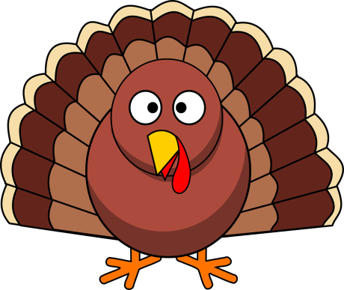
11. before [bɪˋfɔr] prep. 在…之前
【例】My birthday is next week. It’s _______ day ________ Thanksgiving.
(我的生日在下個禮拜。那是感恩節的前一天。)
the
before

Slide 13
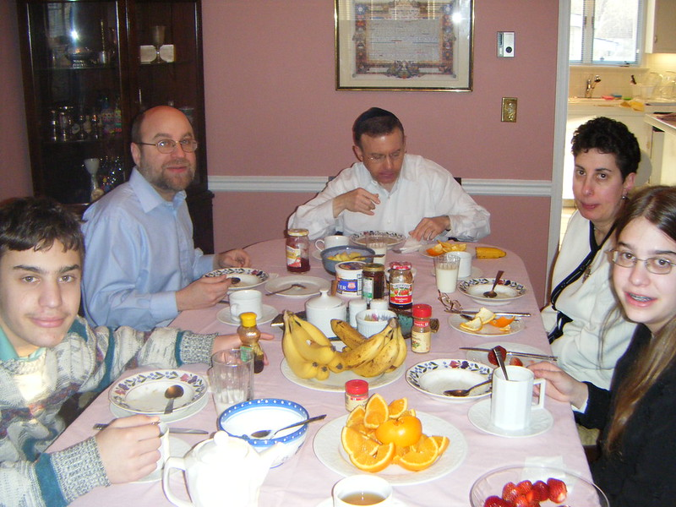
12. around [əˋraʊnd] adv.; prep. 圍繞；在…附近
【例1】Let’s take a ______ ________ the park.
(我們在公園附近散個步吧。)
【例2】Let’s go _______ the table and give our ________.
(我們來按照順序表達我們的感謝吧。)
walk
around
around
thanks

Slide 14
13. How about …? [͵haʊ əˋbaʊt] 那…呢？
 用在「反問」
【例】Jesse: I’m a K-pop fan. ______ _______ _______?
Judy: I am, _______.
(Jesse：我是 K-pop 迷。你呢？
Judy：我也是。)
【補充】也可以用 What about…?
How
about
you
too

Slide 15
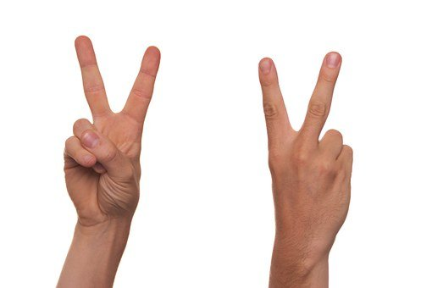
14. second [ˋsɛkənd] adj.; adv.; n. 第二（的）
【例】Rose is Mrs. Brown’s ________ daughter.
(Rose 是 Brown 太太的第二個女兒。)
【補充】也可以當時間單位: 秒
There are 60 seconds in a minutes.
(一分鐘有六十秒)
second

Slide 16
15. next [nɛkst] adj. 下一個的
【例】
Mother’s day is ________ Sunday.
(下週日是母親節。)
【複習】next to 在旁邊
Can I sit next to you?
(我可以坐在你旁邊嗎？)
next

Slide 17
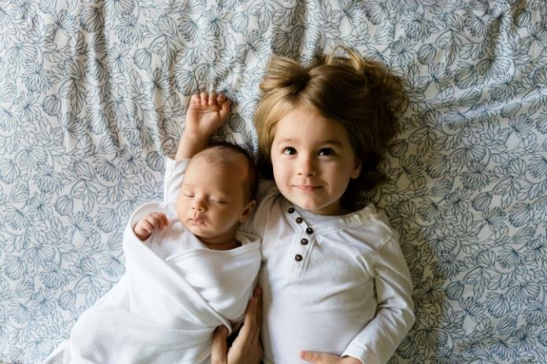
16. month [mʌnθ] n. 月份
【例】My baby sister is seven ________ _____.
(我的小妹七個月大。)
months
old

Slide 18
月份 months
17 | 一月 |  | [ˋdʒænjʊ͵ɛrɪ]
18 | 二月 |  | [ˋfɛbrʊ͵ɛrɪ]
19 | 三月 |  | [mɑrtʃ]
20 | 四月 |  | [ˋeprəl]
21 | 五月 |  | [me]
22 | 六月 |  | [dʒun]
January
February
March
April
May
June

Slide 19
月份 months
23 | 七月 |  | [dʒuˋlaɪ]
24 | 八月 |  | [ˋɔgəst]
25 | 九月 |  | [sɛpˋtɛmbɚ]
26 | 十月 |  | [ɑkˋtobɚ]
 | 十一月 |  | [noˋvɛmbɚ]
27 | 十二月 |  | [dɪˋsɛmbɚ]
July
August
September
October
November
December

Slide 20
【例1】_________ is between
________ and ________.
(四月在三月和五月之間。)
April
March
May

Slide 21
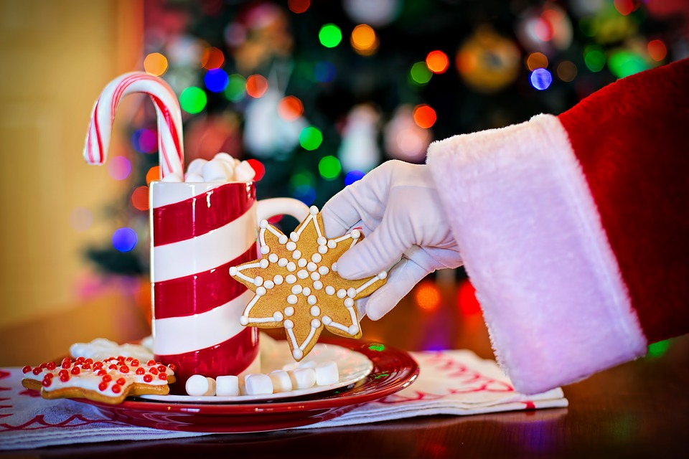
【例2】Christmas is ____ ____________.
(聖誕節在十二月。)
【例3】Father’s Day is _______
__________ ________ in Taiwan.
(台灣的父親節在八月八日。)
in
December
on
August
eighth

Slide 22
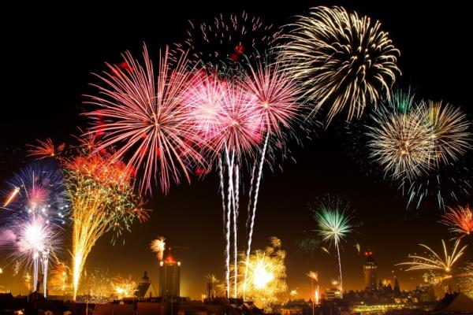
28. New Year’s Eve [͵nju jɪrzˋiv] n. 元旦前夕
 ______ (n.) 前一天晚上
【例】
_______ _______ _______ is on December thirty-_______.
(元旦前夕在 12 月 31 日。)
eve
New
Year’s
Eve
first

Slide 23
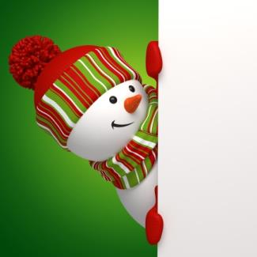
29. Christmas [ˋkrɪsməs] n. 聖誕節
【例】 _________ is around the corner!
Let’s write Christmas cards for our friends.
(聖誕節快到了！
我們來寫聖誕卡片給我們的朋友吧。)
Christmas

Slide 24
30. third [θɝd] adj.; adv.; n. 第三（的）
【例】March is ______ _______ month of the ________.
(三月是一年的第三個月。)
the
third
year

Slide 25
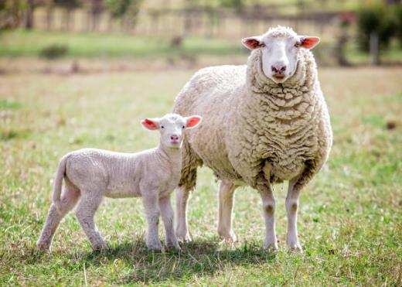
31. animal [ˋænəm!] n. 動物
【例】They are very happy, but the ________
on their _______ are not.
(他們很開心，但是農場裡的動物不開心。)
animals
farm

Slide 26
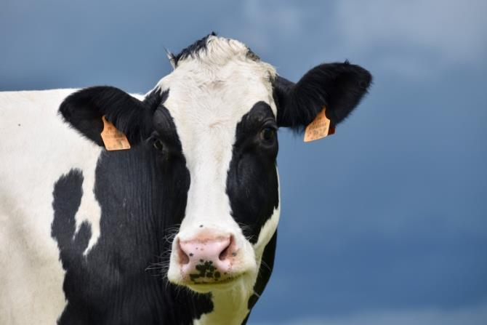
32. cow [kaʊ] n. 牛；乳牛
【例】People can get milk from ________.
(人們可以從乳牛身上取得牛奶。)
【補充】
cash cow ____________
cows
搖錢樹

Slide 27
33. lucky [ˋlʌkɪ] adj. 幸運的
 _______ (n.) 運氣
【例】Americans see “seven” as a _______ _________.
(美國人把“7”視為幸運號碼。)
【例】Yuki: It’s my turn to take the test.
Jamie: Good luck!
(Yuki: 輪到我要考試了。 Jamie:祝你好運！)
luck
lucky
number

Slide 28
34. only [ˋonlɪ] adv.; adj. 只是；唯一的
【例1】Judy is ______ _______ girl in her family.
(Judy是家裡的獨生女。)
【例2】Joe’s wife _____ ______ taking a walk.
(Joe 的太太只是在散步而已。)
the
only
is
only

