Slide 1
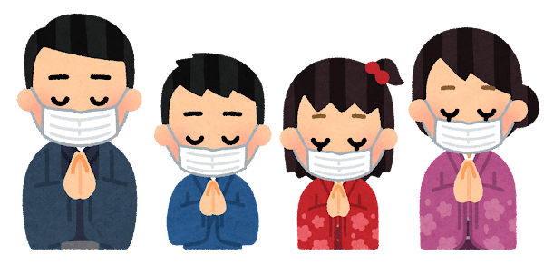
1
Notes:
圖片來源：https://www.irasutoya.com/

Slide 2
1
Protect Health
Section 1
Everyday Is a Healthy Day
Section 2
Healthy Life and Good Shape
Section 3
Global Epidemic
Prevention Strategy
Section 4
Chronic, Please Don’t Come!
Section 5
Take Care Old Age
Notes:
圖片來源：https://www.irasutoya.com/

Slide 3
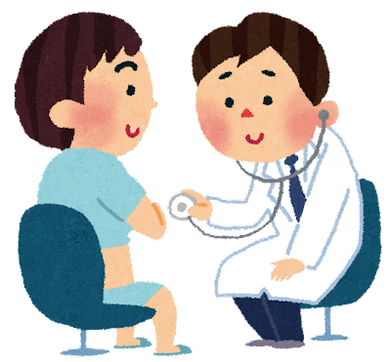
4
慢性病
請不要來
第
節

Slide 4
Section
4
Chronic,
Please Don’t Come!

Slide 5
防癌先鋒
CH.1 守護健康
1-4慢性病請不要來
補
七大癌症警訊
異常腫塊或增厚
大小便異常
消化吞嚥因難
聲音嘶啞或咳嗽
難以癒合的傷口
痣/疣形狀改變
不正常的出血或分泌物
Notes:
參考網址：https://heho.com.tw/archives/46371

Slide 6
CH.1 Protect Health
1-4 Chronic, Please Don’t Come
Cancer Pioneer
additional
Seven Cancer Alerts
unusual lump or thickening
abnormal excretion
difficulty in digestion and swallowing
hoarseness or cough
hard-to-heal wounds
mole/wart shape change
unusual bleeding or discharge
Notes:
參考網址：https://heho.com.tw/archives/46371

Slide 7
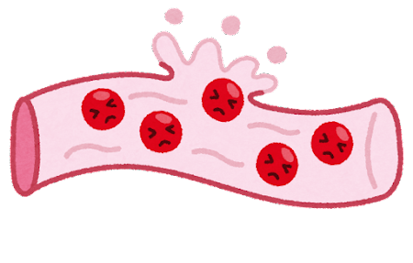
3
心血管疾病

Slide 8
3
Cardiovascular Diseases

Slide 9
3
CH.1 守護健康
1-4慢性病請不要來
060
心血管疾病
心血管疾病又稱「循環系統疾病」
泛指因循環系統功能異常引起的心臟和血管疾病
攝取過多油脂、膽固醇等
→血液的濃稠度提高
正常血管
血管變窄
血管壁沉積過多膽固醇、 尼古丁的刺激與缺乏運動等
→血管變窄、缺乏彈性
心血管疾病
高血壓、冠心病、腦中風
長期血壓升高

Slide 10
3
CH.1 Protect Health
1-4 Chronic, Please Don’t Come
060
Cardiovascular diseases
Cardiovascular disease, also known as "circulatory system disease"
A general term for heart and vascular diseases caused by abnormal circulatory system function
normal blood vessels
narrowing of blood vessels
Excessive intake of fat, cholesterol, etc.
→The consistency of blood increases
Excessive cholesterol deposition in blood vessel walls, stimulation of nicotine and lack of exercise, etc.
→Narrowing and lack of elasticity of blood vessels
Cardiovascular Diseases
Hypertension, Coronary heart disease, Stroke
long-term elevated blood pressure

Slide 11
3
CH.1 守護健康
1-4慢性病請不要來
060
心血管疾病
什麼是動脈粥樣硬化？
因油脂累積、使血管壁內膜增厚，形成粥狀斑塊，造成動脈粥狀硬化，心肌得不到足夠血液，導致血管硬化、狹窄， 甚至阻塞的現象，影響心臟正常功能。

Slide 12
3
CH.1 Protect Health
1-4 Chronic, Please Don’t Come
060
Cardiovascular diseases
What is atherosclerosis?
Due to the accumulation of oil, the intima of the blood vessel wall thickens, forming atherosclerotic plaque, resulting in atherosclerosis, and the myocardium cannot get enough blood, resulting in vascular sclerosis, stenosis, and even obstruction, which affects the normal function of the heart.

Slide 13
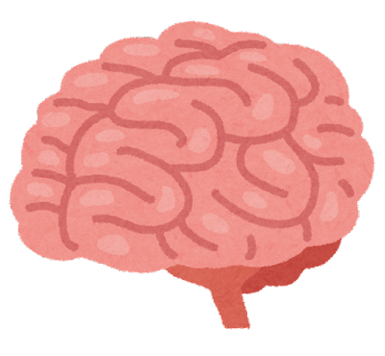
3
CH.1 守護健康
1-4慢性病請不要來
061
心血管疾病
中風
中風，指的是突發性的腦血管疾病。
缺血型
腦中風
出血型
腦中風
(約占75%)
(約占20%至25%)
腦血管破裂，產生血塊壓迫腦細胞及影響供血
腦血管阻塞所造成

Slide 14
3
CH.1 Protect Health
1-4 Chronic, Please Don’t Come
061
Cardiovascular diseases
stroke
Stroke refers to sudden cerebrovascular disease.
ischemic stroke
hemorrhagic
stroke
(about 75%)
(about 20%to 25%)
Cerebral vascular blockage
Cerebral blood vessels rupture, resulting in blood clots that compress brain cells and affect blood supply

Slide 15
3
CH.1 守護健康
1-4慢性病請不要來
061
心血管疾病
FAST 四步驟 - 簡易辨識中風前兆
臉部表情不對稱
或出現嘴角歪斜
手臂無力或出現
單側手臂下垂
口齒不清或
無法表達
記錄發病時間，
儘速就醫
一但發現有中風症狀，請把握黃金三小時緊急送醫!

Slide 16
3
CH.1 Protect Health
1-4 Chronic, Please Don’t Come
061
Cardiovascular diseases
Four Steps to FAST - Simple Recognition of Stroke Precursors
Asymmetrical facial expressions or crooked corners of the mouth
Arm weakness or unilateral drooping of the arm
Slurred speech or
unable to express
Record the time of onset, seek medical attention as soon as possible
Once you find that you have stroke symptoms, please take advantage of the golden three hours to go to the doctor urgently!

