Slide 1
5
Kyoto*:
The Heart of Japan

Slide 2
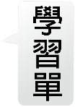
Thinking Ahead
Reading Selection
Vocabulary & Phrases
Reading Strategy
課文動畫
課文Edpuzzle
全課音檔
Words for Production
Paragraph
Idioms and Phrases
1
2
3
5
Words for Recognition
4
寫作手冊
Language Highlight
infographic
Sentence Pattern
Reading Strategy
Note the Details
Language in Use
補充資源
Reading Comprehension
See a Film
Listening Strategy
Graphic Organizer
補充網站
補充學習單
Comprehension Practice
Think and Reflect

Slide 4
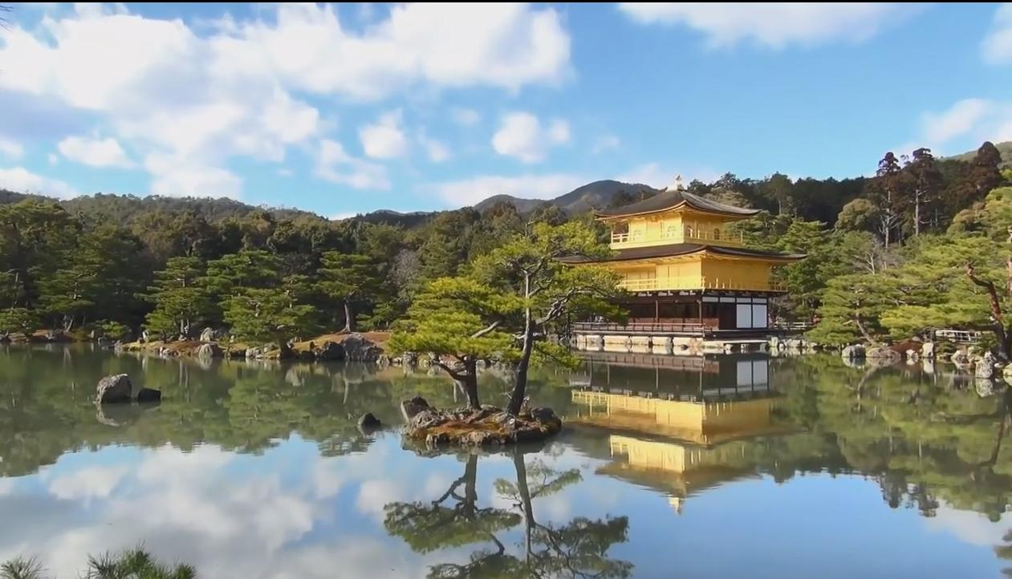
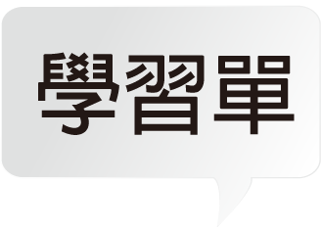
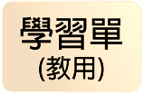
無字幕版
英文字幕
中英字幕

Slide 5
Watch the video and check what you can do at the following tourist attractions in Kyoto.
(1) Arashiyama District
☐ Take a river cruise* or ride a scenic train.
☐ Stroll in a bamboo forest.
Word Bank
cruise 乘船遊覽

Slide 6
Watch the video and check what you can do at the following tourist attractions in Kyoto.
(2) Ryoanji Temple
☐ Try traditional cuisine—boiled tofu.
☐ Learn about garden and landscape design from a monk.
(3) Kinkaku-ji
☐ Play with snow monkeys.
☐ See the golden temple at sunset.

Slide 7
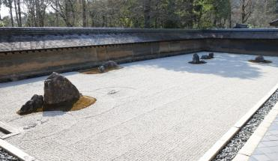
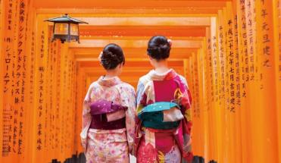
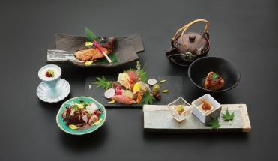
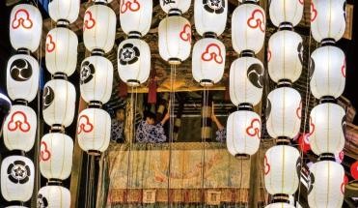
Look at the pictures. What kind of city do you think Kyoto is and why?
I think Kyoto is a city... because....

Slide 8
回題目
Look at the pictures. What kind of city do you think Kyoto is and why?
I think Kyoto is a city of rich diversity because tourists can enjoy a variety of fascinating activities there. For example, they can meditate in an ancient temple, indulge themselves in fine cuisine, dress like geishas and take a stroll along the city’s historic alleys, or observe unique traditions and festivals.

Slide 10
Visualizing
Visualizing is one kind of active reading strategy. Like reading comics or watching cartoons, readers imagine they are right at the scene of the described events, and they imagine objects or details using different senses. Doing this helps readers remember more details of the text, and vividly comprehend the events or objects. Because readers have different prior knowledge and past experiences, the way they visualize things may vary a lot.

Slide 11
回閱讀策略
視覺化（文本訊息）
視覺化是主動的閱讀策略之一。就像在閱讀漫畫或看動畫時，讀者想像自己置身在場景或事件中，利用不同感官感受去想像情節中的物體或是細節。這樣可以幫助讀者記住更多文本細節，並清晰地理解所想像的情節或是物體。也因為讀者自身不同的知識或過去的經驗，所想像出來的事物也會有所差異。

Slide 12
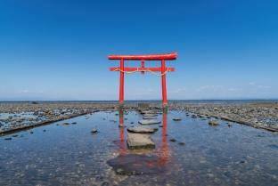
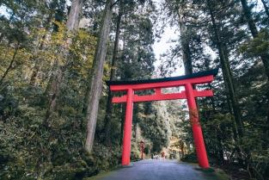
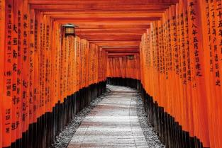
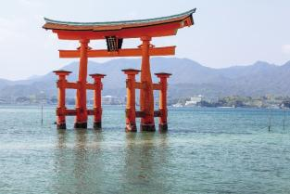
文本
Read the text on the next page and circle the picture below that best fits the description of the Great Torii of Itsukushima Shrine.
A.
B.
C.
D.

Slide 13
文本
B
Which of the following statements can be inferred from the text?
(A) The Japanese believe that each Torii contains a god.
(B) Torii are widely regarded as representations of Japanese culture.
(C) Visitors to the Great Torii have a better experience when the tide is high.

Slide 14
The Great Torii of Itsukushima Shrine*
回題目
Torii are one of the most recognizable* symbols of Japanese culture. These gates form the entrance to Shinto shrines*. They separate the human world outside from the space of the gods inside. One of Japan’s most famous torii is the Great Torii (or the O-Torii) of Itsukushima Shrine on the island of Itsukushima.
Word Bank
the Great Torii of Itsukushima Shrine 嚴島神社大鳥居 recognizable 可識別的 Shinto shrine 神社

Slide 15
回文本
嚴島神社大鳥居
鳥居是日本文化中，最有辨識度的象徵物之一。這些鳥 居形成通往神社的入口。它們用以分隔外界的人間與門內的神祇所在空間。位於嚴島上，嚴島神社的大鳥居，是日本最知名的鳥居之一。

Slide 16
The Great Torii of Itsukushima Shrine*
回題目
The Great Torii is quite different from others—it stands in ocean water about two hundred meters off the coast! Two giant pillars* rise from the water and hold two heavy beams*. There are two smaller supporting pillars on each side of the Great Torii, and they are connected by smaller beams to the main pillars.
Word Bank
pillar 柱子 beam 橫梁

Slide 17
回文本
嚴島神社大鳥居
大鳥居最特別、與其他鳥居不同之處是它矗立在離岸約 2百公尺的海中。它左右2根柱子，突出水面聳立，撐起2根厚重的水平橫梁。大鳥居2根柱子的2側，各有2根較細支柱，由細梁與柱相接。

Slide 18
The Great Torii of Itsukushima Shrine*
回題目
Another special thing about the Great Torii is that it offers different experiences for viewers depending on the tides. When the tide is high, it appears to float, and its bright red color stands out magically against the sea around it. By contrast, low tide allows people to walk right up to it. Viewing the towering structure from below is a breathtaking experience.

Slide 19
回文本
嚴島神社大鳥居
大鳥居另一個特別之處是，在不同潮汐高度下，會給觀賞 者不同感受。漲潮時，亮紅色的大鳥居看似神奇地浮在周遭海水面之上。反之，退潮時，人們可以徒步走近它，從下方往上看，它高聳的結構，讓人屏息。

Slide 20
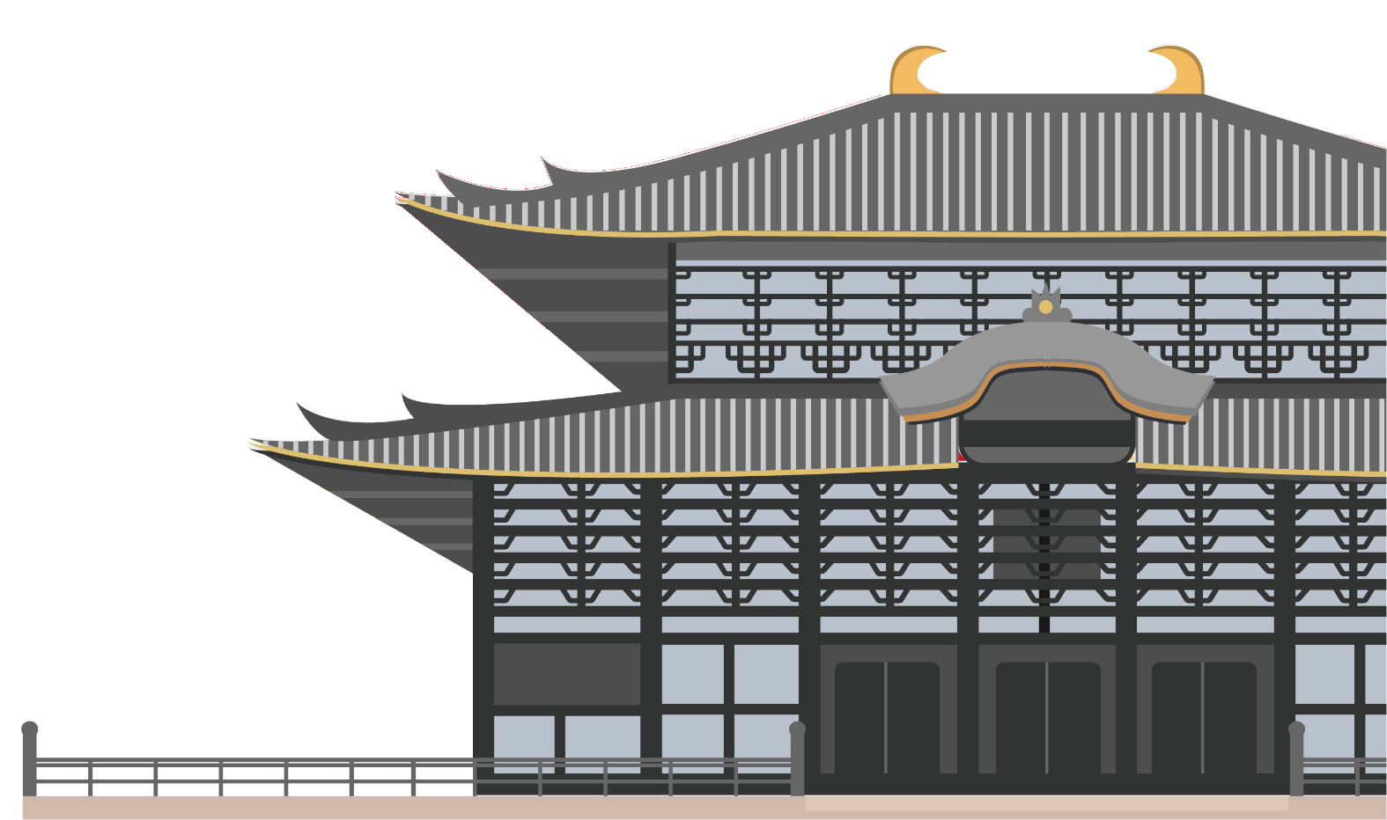
The Great Torii of Itsukushima Shrine*
回題目
Only by seeing it for yourself can you truly appreciate this one-of-a-kind structure!

Slide 21
回文本
嚴島神社大鳥居
只有親眼所見，才能真正體會這獨一無二之建築！

Slide 23
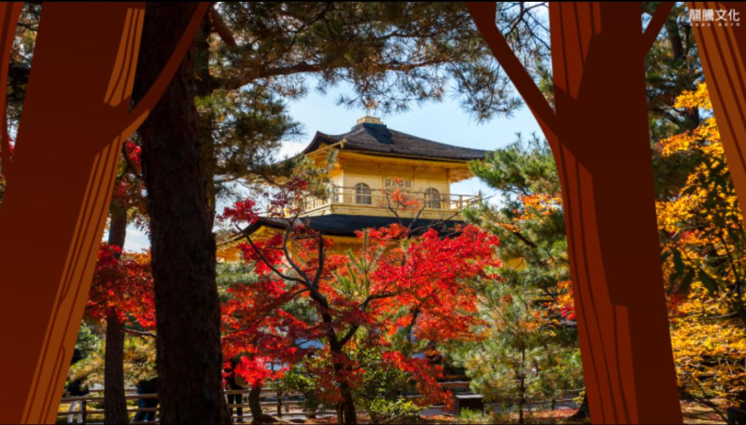
無字幕版
英文字幕
中英字幕

Slide 24
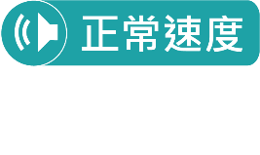
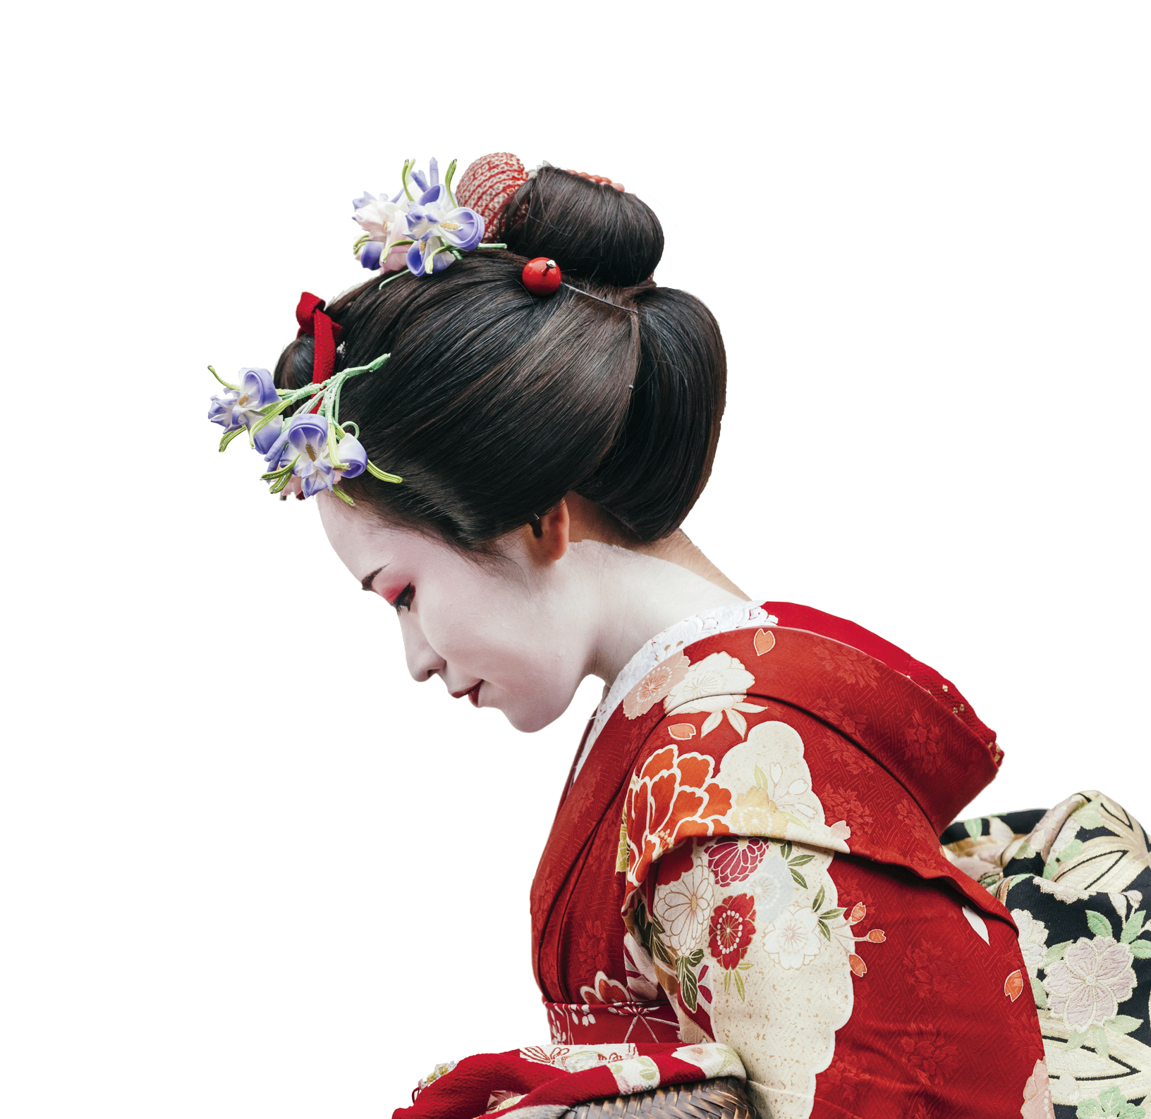
Kyoto, like a beauty in a bright and colorful kimono*, delights tourists throughout the year. In spring romance is in the air as the city is filled with a sea of pink cherry* blossoms¹.
京都，就像穿著鮮豔色彩和服的一位美女，一年到頭都讓遊客感到賞心悅目。春天時，當城市布滿盛開粉紅色櫻花的花海，浪漫的氣息也飄盪在空氣中。

Slide 25
In summer, green leaves can be heard rustling* in the wind and seen sparkling in the sunshine. Maple* leaves in autumn set the landscape* on fire with orange and red colors. Then, when winter comes, white snow turns the whole city into a magic, silver kingdom.
夏天時，可以聽到翠綠樹葉在風中沙沙作響，也可以看到它們在陽光裡閃閃發光。秋天的楓葉用橘色和紅色點燃整片風景。接著，當冬天來臨，白雪將整座城市變成一個奇妙的銀色王國。

Slide 26
Maiko
Geisha
Differences between Maikos and Geishas
(Geiko)
Apprentice
Professional
Colorful decorations
Simple decorations
Natural hair
Wig over natural hair
Only the bottom lip is red.
Both lips are red.

Slide 27
Maiko
Geisha
Differences between Maikos and Geishas
(Geiko)
Red collar in the front and back
Full white collar
Long sleeves
Shorter sleeves
A brightly colored
kimono
A less colorful kimono
15~20 years old
Older than 20 years old
Wooden shoes with a high base (known as okobo)
Wooden shoes with a
lower base (known as
geta/zori)

Slide 28
回課文
Circle the keywords that signal the development of Paragraph 1. How is the idea “throughout the year” supported?
(1) In spring、In summer、in autumn、when winter。
(2) There are four seasons in a year. The author mentions what tourists can experience in Kyoto in seasonal order.

Slide 29
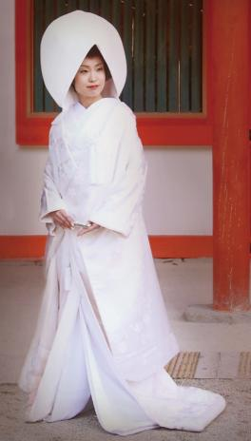
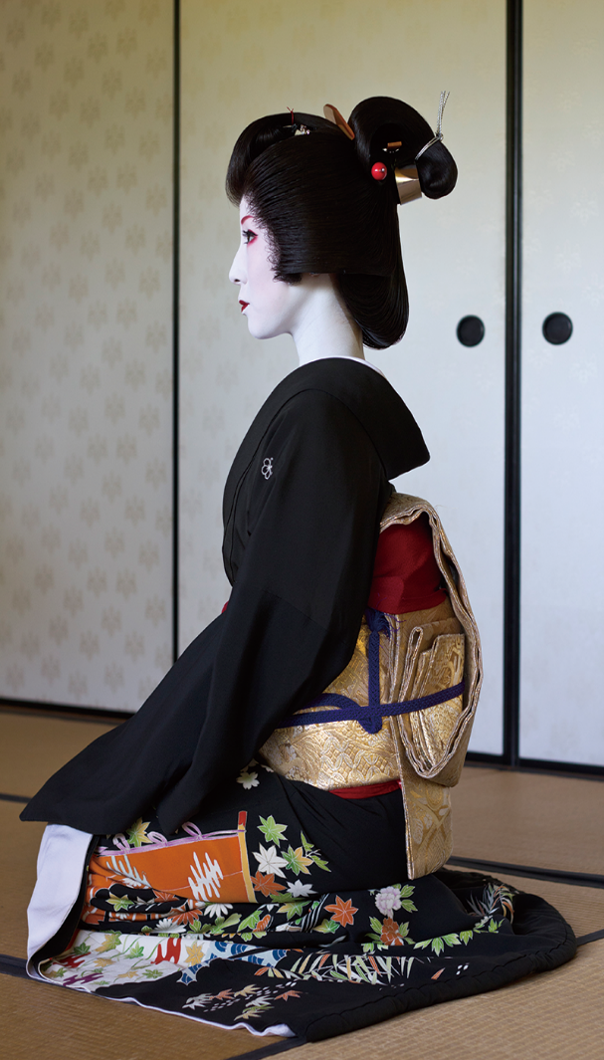
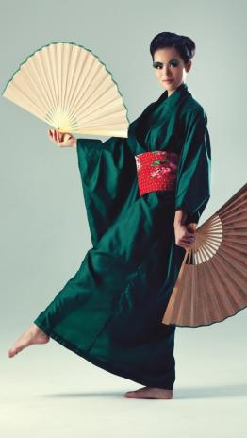
回課文
Visualizing
Check the picture that shows what a geisha looks like.
☐
☐
☐

Slide 30
回課文
Why are there so many historic shrines and temples in Kyoto?
Kyoto used to be the capital of Japan for more than a thousand years.
What is a top attraction in Kyoto and how do we know?
Kinkaku-ji is a top attraction in Kyoto. We know this because it’s one of the most photographed temples.

Slide 31
回課文
3. What is a geisha?
A geisha is a female entertainer who specializes in different musical instruments, songs, and literature. A geisha usually wears a delicate kimono, distinctive white makeup, bright red lipstick, and a graceful hairpin.

Slide 32
1
回課文
(1) like為介系詞，表「就像」。另外，like在此也作為喻詞，是一種明喻的擬人化用法。
(2) in表「穿著」，後方可接顏色或服裝。
Ryan freaked out when he saw a pale woman in red moving toward him in the empty tunnel.

Slide 33
1
回課文
(3) throughout表示「整個⋯⋯」，後方可接一段時間或地方。
There was not even a drop of rain throughout the whole summer.
The firefighters in Australia couldn’t control the fires, so the fires spread rapidly throughout the country.

Slide 34
2
回課文
(1) as為連接詞，意思是「當⋯⋯的時候」。同 when
The noisy students immediately fell silent as their strict teacher walked into the classroom.
(2) be filled with是「充滿⋯⋯」的意思。
Right after the library opened, it was quickly filled with students who were preparing for the college entrance exam.

Slide 35
2
回課文
(3) 此處的sea為隱喻用法，並非指真正的海，而是指「大量」的意思，這裡描述櫻花盛開，就像花海一般。

Slide 36
3
回課文
be heard + V-ing 被聽到⋯⋯

Slide 37
4
回課文
(1) set the landscape on fire並非指真正放了一把火，而是將橘紅的楓葉比擬成火焰般，點綴了整片景色。
(2) with orange and red colors當中的with是「用」的意思。

Slide 38
5
回課文
then為時間轉承語，表示「然後」，詞性為副詞，可提醒學生勿將then當連接詞使用。

Slide 39
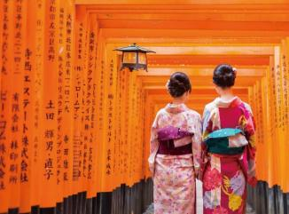
Apart from its natural splendor², Kyoto has so much more to feast one’s eyes on. Having previously³ been the capital⁴ of Japan for over a thousand years, the city boasts⁵ a large number of historic⁶ shrines* and temples.
除了自然景觀的壯麗之外，京都還有更多東西可以讓人盡情欣賞。因為之前身為日本的首都超過一千年的緣故，這座城市以擁有大量具歷史意義的神社和寺廟為傲。

Slide 40
No visit to Kyoto would be complete without seeing one of the most photographed landmarks: the Kinkaku-ji*, or the Golden Pavilion Temple* in English. With giant, leafy maple trees leading up to its main entrance⁷, what comes into view is this magnificent⁸ three-story pavilion.
到京都造訪必定要參觀最常被拍照的地標之一：Kinkaku-ji，或在英文中稱為金閣寺。巨大且多葉的楓樹一路引導通往它的主要入口，映入眼簾的是這座雄偉的三層樓閣！

Slide 41
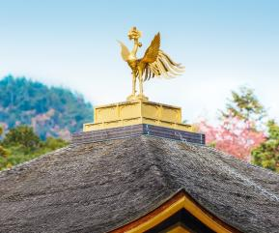
Rising up behind a crystal-clear* pond, it is covered in sparkling gold leaf and crowned with a large bronze* phoenix* on its shimmering* roof. The reflection of the pavilion on the glassy surface of the pond is a breathtaking⁹ sight.
矗立於一個清澈的池塘後面，它被閃耀的金箔所覆蓋，並且被冠上一隻古銅色的大鳳凰在它閃閃發光的屋頂上。在似鏡的池塘表面的樓閣倒影形成一幅令人屏息的景象。

Slide 42
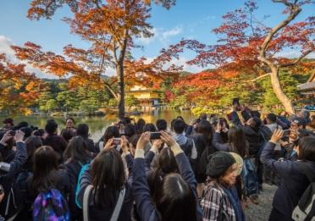
Visitors can take a leisurely¹⁰ walk through the surrounding gardens and enjoy many stunning¹¹ views of this beautiful structure.
遊客可以在周圍的花園裡悠閒地散步，並且欣賞這座美麗建築眾多令人驚豔的景象。

Slide 43
1
回課文
apart from為介系詞片語，表「除⋯⋯之外（尚有⋯⋯）」之意。同 aside from
Apart from Japan, I will also visit Thailand.

Slide 44
2
回課文
(1) 此句為完成式分詞構句的用法，原句為Since the city had previously been the capital of Japan..., ....。
(2) for表「持續」，後面加一段時間，常搭配完成式，表某動作或狀態持續一段時間。
(3) over後面加一段時間，表示某動作狀態持續「超過」那一段時間。同 more than

Slide 45
2
回課文
(4) a large number of + 複數可數名詞，表示「許多⋯⋯」之意，若為不可數名詞，則用a large amount of修飾。
A large number of students are addicted to playing games on their cell phones.
A large amount of useful information on this website can be accessed free of charge.

Slide 46
3
回課文
(1) no...without...為雙重否定以表示肯定的句構。
(2) one of the + 最高級 + 複數名詞，意思是「最⋯⋯的⋯⋯之一」。
Boracay in the Philippines has one of the most beautiful beaches in the world.

Slide 47
4
回課文
(1) with + O + OC用來表示附帶狀況，OC若為主動用現在分詞，被動則用過去分詞。
With the music playing, all the wedding guests joined the bride and groom for a dance.
The victim was found in the cellar with his hands tied behind his back.
(2) lead up to表示「帶往、通往」之意。

Slide 48
4
回課文
(3) what comes into view是由the thing that comes into view簡化而來。當形容詞子句的先行詞為the thing(s)，表達「所⋯⋯的事情／東西」時，先行詞the thing(s)連同後面的關係代名詞that，可一併用what代替，以使文字更精簡。此處what視為單數。
• Never put off till tomorrow what you can do today.
= Never put off till tomorrow the thing that you can do today.
(4) three-story為複合形容詞，結構為「數量詞 + N」，其他例子如a two-meter table、a six-km run。

Slide 49
5
回課文
(1) be covered in表示「被⋯⋯覆蓋」。
The mountain is covered in thick snow.
(2) be crowned with表示「被⋯⋯冠上」。
This church is crowned with a statue of Jesus.
(3) on...roof表示「在屋頂之上」。

Slide 50
6
回課文
on the surface表示「在表面之上」，另外on the surface也可表示抽象的「表面上」，用以對比in fact所帶出的真實情況。
On the surface, the witch looks like a caring person, but in fact she is selfish and evil.

Slide 51
7
回課文
(1) take a walk為「散步」之意。同 take a stroll
(2) through後方加地點，表「穿越某地」，若後方加一段時間，則表「整段時間從頭到尾。」
Thomas walks through the park every morning to get to the metro station.
All the guests stayed through the whole party.

Slide 52
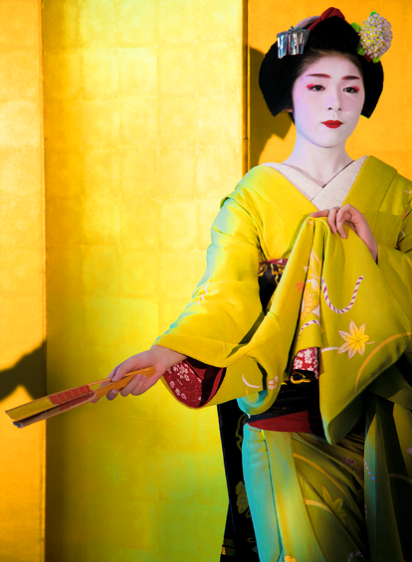
Another unforgettable Kyoto sight involves coming face to face with one of the old capital’s very special “persons of art,” or geishas*. These are women dressed in delicate¹² kimonos with silk sleeves.
另一個令人難忘的京都景象包含面對面接觸這座古都其中一個非常特別的「藝術從業人員」，或稱藝妓。這些女性穿著精美的和服，並有著絲綢的袖子。

Slide 53
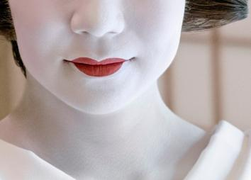
Their distinctive¹³ white makeup, bright red lipstick*, and graceful¹⁴ hairpins* also make them easy to recognize. And it’s not just their unique appearance¹⁵ that makes geishas stand out from the crowd.
她們獨特的白色妝容、鮮紅的口紅和優美的髮簪也都使得她們容易被辨認。而且不是只有她們獨特的外表讓藝妓在人群中顯眼。

Slide 54
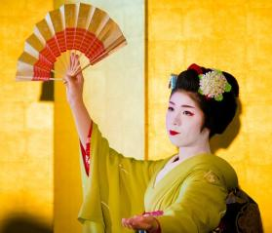
These highly skilled entertainers spend years mastering different musical instruments¹⁶, songs, and literature¹⁷. Of course, no “person of art” could be a true geisha without being able to perform the traditional kyomai* dance.
這些具有高度技巧的表演者也花費多年時間來精通不同的樂器、歌曲和文學。當然，所有「藝術從業人員」肯定要能夠表演傳統的京舞才能成為一名真正的藝妓。

Slide 55
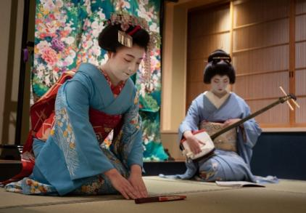
This ancient art combines slow music with very deliberate¹⁸ movements, and often expresses very deep emotion.
這種古老的藝術結合了緩慢的音樂以及非常小心翼翼的舞步，而常常表現出非常深刻的情感。

Slide 56
1
回課文
(1) 由於在第13行∼第14行已經用one of the most photographed landmarks來帶出金閣寺，故此段以another來帶出另外一個京都令人難忘的景象。雖然本課主要介紹金閣寺和藝妓這兩個京都特色，但京都的特色遠遠多於本課所介紹的，故不能使用one和the other的方式來帶出本課的兩個主題。

Slide 57
1
回課文
(2) involve為「包含」之意，後面可接名詞或動名詞。此外，involve也有「牽涉；牽扯」的意思，常使用被動的用法。
The exam will involve answering questions about a news article.
According to the news report, the politician was involved in a bribery scandal.

Slide 58
2
回課文
(1) dressed in delicate kimonos為分詞片語的用法，用來修飾前面的women，也可將此分詞片語還原為關係子句的用法，變成who/that are dressed in delicate kimonos來修飾women。
(2) 此處的with是「有」的意思，表示和服上有著絲綢的袖子。
This is an apartment with three bedrooms, two bathrooms, and one kitchen.

Slide 59
3
回課文
(1) ①此句為分裂句的用法，主要結構為it is/was...that....，此句型用於強調句子的某個部分，將想要強調的部分置於it is/was與that的中間部位。
②若強調的部分為人，that也可用who代替。
It was Jolin that/who Jay kissed last night.

Slide 60
3
回課文
(2) make為使役動詞，若其後受詞接主動動作，則用原形動詞，被動則用過去分詞。
My mom made me clean my room last night, because she said it was too messy.
The speaker used simple English so that he could make himself understood by the students.

Slide 61
4
回課文
spend、cost和take皆可當「花費」的意思，但其用法不盡相同：
I spent 20,000 dollars on my new TV.
Jade spent a whole day preparing for the exam.
人 | spend | 金錢╱時間 | V-ing/on + N

Slide 62
4
回課文
事物 | cost | 人 | 金錢 | （to VR）
It |  |  |  | to VR
The broken screen on my cell phone cost me 3,000 dollars to fix.
It cost me a lot of money to buy the house.

Slide 63
4
回課文
事物 | take | 人 | 時間 | （to VR）
It |  |  |  | to VR
Planning our trip to Europe took us one month. It took us one month to plan our trip to Europe.

Slide 64
5
回課文
combine A with B表示「將A和B結合在一起」，也可說combine A and B。
You are very lucky to be able to combine work with pleasure.

Slide 65
In Kyoto, culture and natural beauty flow together like the graceful motions of kyomai. Regardless of the season, the city is a must-see* destination¹⁹ for tourists seeking an authentic local experience. Those who visit are likely to end up falling in love with the heart of Japan.
在京都，文化和自然之美匯流在一起，就像京舞優雅的動作。無論什麼季節，這座城市對於追求真正地方體驗的遊客來說，都是一個必須參觀的目的地。那些造訪的人很可能最後會愛上這日本之心。

Slide 66
1
回課文
regardless of為「不管；無論」之意，後面接名詞，表示主要子句所描述的內容不會受到regardless of後面所接名詞的影響。
Everyone should be treated equally, regardless of age and sex.

Slide 67
2
回課文
(1) those who也可用people who或是they who來代替，意思是「凡是⋯⋯的（人）」，常用於定義。
God helps those who help themselves.
(2) be likely to表示「可能」之意，與possible最大不同之處在於be likely to可用人當主詞，而possible通常用虛主詞it開頭，impossible若用人當主詞，意思是「難以忍受」之意。

Slide 68
2
回課文
According to the report, the Hollywood superstar is likely to visit Taiwan next week.
Some people believe that it is possible for humans to communicate with animals.
You are impossible at times.

Slide 69
2
回課文
(3) end up表示「最終」之意，後方可接多種詞性，整理如下：
end up | V-ing | John was addicted to gambling and ended up losing all his money.
 | adj. | Having no money, he ended up penniless.
 | N | Unfortunately, he ended up a bank robber.
 | 介系詞片語 | After he was caught, he ended up in prison.

Slide 70
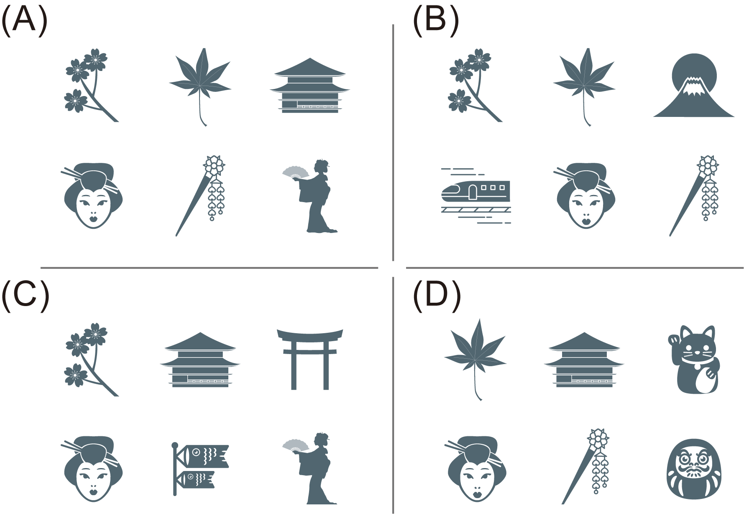
Reading Comprehension
A
Julia is an editor of the textbook, and she wants to add some icons to the passage. According to the contents, which of the following is the best choice for her?

Slide 71
Sensory* details can enrich a descriptive text. Use the graphic organizer to review the words used to describe the beauty of Kyoto and how the sentences are organized. Fill in the blanks with the words related to color, shape, appearance, and touch that you can find in the passage as well as in the box on the right.
Word Bank
sensory 感官的

Slide 72
(D)
sparkling gold
題目 Time
(A)
green
(B)
red
(C)
broze
Location
Person
(F)
crystal-clear
(E)
giant, leafy
(G)
three-story
(H)
delicate
(I)
silk
(J)
pink
(K)
white
(L)
shimmering
(M)
bright red
(N)
orange
(O)
silver
(P)
graceful

Slide 73
選項
Time
Season Spring → Summer → Autumn → Winter
a sea of ¹ cherry blossoms→² leaves can be heard rustling and seen sparkling → maple leaves in ³ and ⁴ colors → white snow turns the city into a(n) ⁵ kingdom
J
A
N
B
O

Slide 74
選項
Location
The Golden Pavilion Temple Near → Far
⁶ maple trees → the main entrance → a(n) ⁷ pond → the ⁸ pavilion covered in ⁹ leaf and crowned with a large ¹⁰ phoenix on its ¹¹ roof
E
F
G
D
C
L

Slide 75
選項
Person
Geisha Outside → Inside
dressed in ¹² kimonos with ¹³ sleeves, and wear ¹⁴ makeup, ¹⁵ .lipstick, and ¹⁶ hairpins → master different musical instruments, songs, and literature, and perform the traditional dance
H
I
K
M
P

Slide 76
General Understanding
B
1. What does the first paragraph mainly describe?
(A) The geishas in colorful kimonos.
(B) The seasonal splendors of Kyoto.
(C) Must-see tourist attractions in Kyoto.
(D) The graceful, flowing motions of kyomai.

Slide 77
回閱讀理解評量
大意理解
1. 第一段主要在描述什麼？
(A)穿著色彩鮮豔和服的藝妓。
(B)京都四季迷人的風采。
(C)京都一定要去的觀光勝地。
(D)京舞優雅流暢的舞蹈動作。

Slide 78
Key Details
A
Which of the following statements is NOT true about the Golden Pavilion Temple?
(A) It is surrounded by a dry landscape.
(B) It is covered in sparkling gold leaf.
(C) It is one of Kyoto’s most photographed landmarks.
(D) It is a three-story pavilion with a pond in front of it.

Slide 79
回閱讀理解評量
關鍵細節
2. 關於金閣寺的敘述，下列何項為非？
(A)它被乾燥的景觀所環繞。
(B)它被閃亮的金箔所覆蓋。
(C)它為京都最常被拍照的地標之一。
(D)它為三層樓的閣樓建築，前方有一窪池塘。

Slide 80
Inference
B
What can be inferred about Kyoto?
(A) The city sees most of its visitors in summer.
(B) Photos of it look very different depending on the season.
(C) Tours there are quite expensive because there are few of them.
(D) Most of the famous buildings there were built in modern times.

Slide 81
回閱讀理解評量
推論
3. 關於京都，何項敘述可被推斷出來？
(A)在夏天來京都的觀光客最多。
(B)京都的風采樣貌會隨不同季節拍起來而不同。
(C)京都旅遊很昂貴，因為所提供的行程不多。
(D)多數有名的建築物都建造於現代。

Slide 82
1. As a tourist, what would you like to do in Kyoto and why?
I think I’d like to visit shrines and temples because they often appear in Japanese comics and animations and have a magical appeal to me. I’d like to walk around them, take lots of photos of them, and most important of all, buy an omamori (lucky charm) as a souvenir.
I think I’d like to...because....

Slide 83
If you were asked to introduce your city to foreign tourists, what would be the first thing you would recommend doing or seeing, and why?
I’d first recommend...to foreign tourists because....

Slide 84
回題目
I’d first recommend visiting a Goddess of the Sea temple to foreign tourists because they could take beautiful photos there. There are many colorful and delicate sculptures inside and outside these temples, as well as on the roof and pillars. In addition, tourists can ask the goddess for advice by drawing a fortune stick if they are encountering any problems in their lives. The stick can shed light on possible solutions to their problems. I think this could be a special cultural experience for foreign tourists.

Slide 85
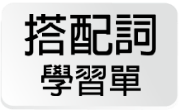
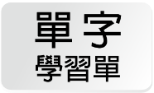

Slide 86
1
blossom
8
magnificent
15
appearance
2
splendor
9
breathtaking
16
instrument
3
previously
10
leisurely
17
literature
4
capital
11
stunning
18
deliberate
5
boast
12
delicate
19
destination
6
historic
13
distinctive
7
entrance
14
graceful

Slide 87
回課文
1. blossom
n. [C, U] 花朵；開花 a flower or group of flowers, especially those found on blooming fruit trees
Apple blossoms are beautiful white flowers, but did you know they’re actually poisonous to cats?
蘋果花是美麗的白色花朵，但是你知道它們其實對貓是有毒的嗎？

Slide 88
回課文
1. blossom
n. [C, U] 花朵；開花 a flower or group of flowers, especially those found on blooming fruit trees
When cherry trees are in blossom across Japan, tourists flock to the country’s parks and temples.
當全日本各地櫻花盛開時，遊客都聚集到這個國家的公園和寺廟。

Slide 89
回主單
blossom n. [C, U] 花朵；開花
Pretoria is a city in South Africa that is well known for its jacaranda (藍花楹) trees with their beautiful purple blossoms.
People in Europe and America traditionally associate the orange blossom with weddings because it symbolizes innocence.

Slide 90
回主單
延伸補充
blossom和bloom皆可解釋為「花朵」，但其不同之處在於bloom指的是植物上的一朵花，而blossom可指的是樹上的一朵花或是全部的花朵。此外，blossom通常指果樹的花朵，如apple blossom、orange blossom、cherry blossom等等。

Slide 91
回課文
blossom
vi. 開花
The purple flowers of star fruit trees only blossom in summer, while most other fruit trees do so in spring.
楊桃樹紫色的花只會在夏天盛開，而其他大部分的果樹都在春天開花。

Slide 92
回衍生
blossom vi. 開花
April is perfect for visiting Osaka and Kyoto because it’s when the local cherry trees begin to blossom.
blossom vi. 變得更加健康（或自信、成功）
Lauren was shy and timid (膽小的) when she was a little girl, but now she has blossomed into a confident young woman.

Slide 93
回課文
2. splendor
n. [U] 壯麗；雄偉 very fine, grand, or impressive beauty
As the climbers reached the mountain peak, the splendor of the sunrise over the valley took their breath away.
當登山客抵達山頂時，山谷上方日出的壯麗令他們讚嘆。

Slide 94
回主單
splendor n. [U] 壯麗；雄偉
Few structures in the world can compare with the architectural splendor of the Sagrada Família (聖家堂) in Barcelona, Spain.
splendors n. pl.（尤指某地的）壯麗景色
Every year, the many splendors of Venice attract millions of tourists from around the world.

Slide 95
回課文
splendid
adj. 壯麗的；雄偉的
Nearly five million tourists visited Taroko National Park to enjoy its splendid scenery last year.
去年有將近五百萬名遊客造訪太魯閣國家公園以欣賞它雄偉的景色。

Slide 96
回衍生
splendid adj. 壯麗的；雄偉的
Visitors to the Grand Canyon in Arizona are always amazed by the splendid views.

Slide 97
回課文
splendid
adj. 非常好的
It was a splendid idea to take the MRT home. Look at how bad the traffic is on the road!
搭捷運回家是一個很棒的想法。看看路上交通有多糟！

Slide 98
回衍生
splendid adj. 非常好的 同 marvelous, excellent
From his cabin on the top of the mountain, my grandfather has a splendid view of the whole valley below.

Slide 99
回課文
3. previously
adv. 先前地
in the past; before; formerly
Alison works as a receptionist now, but previously she was a flight attendant.
Alison現在的工作是接待員，但是之前她是一位空服員。

Slide 100
回主單
previously adv. 先前地
Stephen was previously employed as a salesperson, but now he is looking for an opportunity to work in show business.

Slide 101
回課文
previous
adj. 先前的
Though the two graduates had met on a previous occasion, they didn’t seem to recognize each other at the party.
雖然這兩個畢業生在之前的一個場合見過面，但是在派對上他們似乎不認得彼此。

Slide 102
回衍生
previous adj. 先前的 補充 只放在名詞前
In the previous episode of this popular sitcom (情境喜劇), the two main characters were planning to get married, but in today’s show they can’t stand each other!
字詞搭配
(1) previous experience/knowledge 先前的經驗／知識
Previous experience in the same field is not required for this job, so recent graduates can also apply.

Slide 103
回衍生
Clark had no previous knowledge of his grandmother’s heart condition, so it was natural for him to feel shocked when he learned that she was in the hospital.
(2) previous conviction/offense 前科
Although it is unfair, many employers refuse to hire people with previous convictions.

Slide 104
回課文
4. capital
n. [C] 首都 a country’s main or the most important city
No one in the group had previously visited London, so they decided to start their UK trip in the capital.
那群人裡都沒有人之前去過倫敦，所以他們決定他們的英國之旅會從首都開始。

Slide 105
回主單
capital n. [C] 首都
Most people think the capital of Australia is either Sydney or Melbourne, but it is actually Canberra.
字詞搭配
(1) regional/provincial/state capital 地區／省／州首都
Sacramento, which is the state capital of California, is the 9th largest capital in the US.

Slide 106
回主單
(2) cultural/financial capital 文化／金融首都
Although Hanoi is the national capital of Vietnam, Ho Chi Minh City is in fact the largest city and the country’s financial capital.
capital adj. 大寫字母的
In English, capital letters are always placed at the beginning of sentences and names.

Slide 107
回主單
capital adj. 死刑的
Whether capital punishment should be abolished (廢除) has been a matter of debate in this country.

Slide 108
回課文
4. capital
n. [U] 資本；資金
Establishing a company requires not only a great idea for a product but also some start-up capital.
創立一家公司不只需要有一個很棒的產品想法，還需要一些創業資金。

Slide 109
回衍生
capital n. [U] 資本；資金
Lukas has invested a large amount of capital in his new restaurant, but he won’t see any return on this money for a few years.

Slide 110
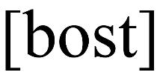
回課文
5. boast
vt. 以⋯⋯為傲；擁有 to have something of great value to be proud of
Our new community sports center boasts six indoor basketball courts, an Olympic-size swimming pool, and four tennis courts.
我們新的社區運動中心引以為傲的有六個室內籃球場、一個奧運尺寸的游泳池和四個網球場。

Slide 111
回主單
boast vt. 以⋯⋯為傲；擁有
Taiwan’s National Palace Museum proudly boasts the world’s largest collections of Chinese artifacts (文物) and artworks (藝術品).
boast vi. 自誇；自吹自擂
Parents are inclined (傾向) to boast about their children’s achievements at school.

Slide 112
回課文
6. historic
adj. 歷史悠久的；歷史上著名的 having importance in history
On April 12, 1961, Yuri Gagarin became the first person to fly into space. It was a historic day for humankind.
在1961年四月十二日那天，Yuri Gagarin成為飛入太空的第一人。那是人類歷史上著名的一天。

Slide 113
回主單
historic adj. 歷史悠久的；歷史上著名的
No trip to Athens is complete without a visit to the Parthenon (帕德嫩神廟), one of the most famous and historic buildings in Greece.
prehistoric adj. 史前的；遠古的
According to some archaeologists (考古學家), Stonehenge (巨石群) may have been a prehistoric burial ground.

Slide 114
回課文
historical
adj. 歷史的
Sophia’s favorite movies are historical ones because she can learn something about the past while being entertained.
Sophia最喜歡的電影是歷史電影，因為她覺得有趣又可以認識些以前的歷史。

Slide 115
回衍生
historical adj. 歷史的
Many important historical documents were damaged when the museum collapsed in the earthquake.

Slide 116
回課文
historian
n. [C] 歷史學家
Historians disagree about when the first humans arrived in North America, but most believe it was over 20,000 years ago.
歷史學家對於第一批人抵達北美洲的時間意見不同，但是大部分都相信時間點超過兩萬年前。

Slide 117
回衍生
historian n. [C] 歷史學家
A historian has the fascinating job of studying and interpreting the past.

Slide 118
回課文
7. entrance
n. [C] 大門；入口
a gate or a door where one can enter a room, building, or place
A large fish which represents the baseball team is found at the entrance to the stadium.
代表這個棒球隊的一條大魚可以在這個體育場的入口被找到。

Slide 119
回主單
entrance n. [C] 大門；入口 反 exit
A collection of cute little wooden sculptures of cats and dogs is displayed at the entrance to this pet-friendly café.
entrance n. sing. 進入；出場；登場
The actor made his first entrance in the restaurant scene, but at that time he didn’t catch the attention of the viewers.

Slide 120
回主單
entrance n. [U] 進入權
Antonio was refused entrance into the night club because he was wearing a pair of shorts and flip-flops.
字詞搭配
entrance fee 入場費
Though local citizens are not charged an entrance fee to get into the national park, foreign visitors do need to purchase tickets.

Slide 121
回課文
8. magnificent
adj. 壯麗的；雄偉的 very beautiful and impressive; wonderful to see
Yangmingshan’s magnificent cherry blossoms only last for about a month, so make sure you get there in time!
陽明山壯觀的櫻花只持續大約一個月左右，所以要確保你能夠及時到那裡！

Slide 122
回主單
magnificent adj. 壯麗的；雄偉的 同 splendid
Tourists visiting Paris wouldn’t want to miss the chance to take a look at the magnificent Palace of Versailles (凡爾賽宮).

Slide 123
回課文
9. breathtaking
adj. 驚人的；極為美麗的 so beautiful or impressive that one almost forgets to breathe
All travelers who have a chance to witness the Northern Lights agree that they are of breathtaking beauty.
所有有機會一睹北極光的旅客都同意北極光極為美麗。

Slide 124
回主單
breathtaking adj. 驚人的；極為美麗的
It is worth spending a few hours climbing the mountain for the breathtaking view of the city from the top.

Slide 125
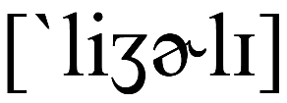
回課文
10. leisurely
adj. 悠閒的 relaxed or without rushing
On his day off, Carlos spent a leisurely afternoon playing catch on the lawn with his kids.
在他休假那天，Carlos在草坪上和他的小孩傳接球度過一個悠閒的下午。

Slide 126
回主單
leisurely adj. 悠閒的
It was Edgar’s habit to take a leisurely walk along a nearby stream after dinner.

Slide 127
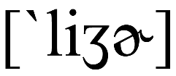
回課文
leisure
n. [U] 閒暇
The employees usually work long hours, so the airline ensures they get enough leisure time to recover completely.
這間航空公司的員工通常工時很長，所以公司確保員工有足夠的閒暇時間以完全恢復體力。

Slide 128
回衍生
leisure n. [U] 閒暇
With two jobs, Leah doesn’t have any free time for leisure activities. All she does is work.
字詞搭配
(1) leisure facilities 休閒設施
The new apartment building offers leisure facilities such as a swimming pool, a gym, and a library.

Slide 129
回衍生
(2) at leisure 有空；清閒
The restaurant staff are seldom at leisure, because they have customers coming in at all hours of the day.
(3) marry in haste, repent at leisure 結婚匆匆，後悔無窮
The phrase “Marry in haste, repent at leisure” is often used to discourage people from getting married in a rush.

Slide 130
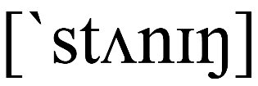
回課文
11. stunning
adj. 撼動人心的；令人驚訝的 extremely beautiful, splendid, or impressive
Marcia really looked forward to the fashion show and couldn’t wait to see the models in their stunning new clothes.
Marcia真的很期待這場時裝秀，而且等不及要看模特兒們穿上令人驚豔的新服裝。

Slide 131
回主單
stunning adj. 撼動人心的；令人驚訝的
The actress gave another stunning performance in her latest film and is expected to win the award for best actress.

Slide 132
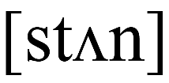
回課文
stun
vt. 使⋯⋯驚訝 (stunned—stunned—stunning)
The visitors were stunned when they saw several huge beasts escaping from the zoo.
遊客看到幾隻巨大的野獸從動物園逃脫都很驚訝。

Slide 133
回衍生
stun vt. 使⋯⋯驚訝
The 2004 Indian Ocean earthquake and tsunami stunned people throughout the world.
stun vt. 使昏迷；（尤指）打昏
The boxer stunned his opponent with a hard punch to the side of his head.

Slide 134
回課文
stun
vt. 使⋯⋯印象深刻
Dancers stunned the crowd with their magnificent performance during the joyous New Year’s celebrations.
在這歡樂的新年慶祝活動中，舞者絕佳的表演讓群眾印象深刻。

Slide 135
回衍生
stun vt. 使⋯⋯印象深刻
The prince of Troy was stunned by Helen’s beauty and decided to take her back to Troy with him.

Slide 136
回課文
12. delicate
adj. 精美的 finely made and beautiful
The exhibit includes a number of delicate Chinese paintings from the 16th century.
這個展覽包括一些十六世紀的精美中國繪畫。

Slide 137
回主單
delicate adj. 精美的
My grandmother’s porcelain (瓷) dishes are very delicate, so she only uses them on special occasions.
delicate adj. 易碎的；脆弱的 同 fragile
Babies should not be exposed to sunlight for too long, because they have very delicate skin.

Slide 138
回主單
delicate adj. 熟練的；需要技巧的
Brain surgery is a very delicate operation. Any minor mistake can cause great damage to the brain.
delicate adj.（顏色、味道、氣味）柔和的；清淡的；清香的 同 subtle
I like the perfume that you are wearing today. It is not too strong and has a delicate floral fragrance.

Slide 139
回課文
delicacy
n. [U] 纖細；精美
Because of the delicacy of the wedding cake, none of the children should be allowed near it.
由於婚禮蛋糕非常精美，小孩都不應該被允許靠近它。

Slide 140
回衍生
delicacy n. [U] 纖細；精美
Because of its great delicacy, the Mona Lisa is kept in a special sealed box to protect it from vibrations, heat, and humidity.
delicacy n. [U] 周到；體貼
Our boss seems to have a short temper lately, so I suggest you treat him with great delicacy.

Slide 141
回課文
delicacy
n. [C] 佳餚；美食
This high-end grocery store sells foreign delicacies, such as cheese from France and soy sauce from Japan.
這間高檔的雜貨店販售外國美食，像是法國來的起司和日本來的醬油。

Slide 142
回衍生
delicacy n. [C] 佳餚；美食
Although pufferfish (河豚) is extremely poisonous, it is considered to be a delicacy in Japan.

Slide 143
回課文
13. distinctive
adj. 獨特的 easy to recognize, identify, or notice
Due to their distinctive sun-like shape and purple coloring, passion flowers in blossom are easy to recognize.
由於它們獨特太陽般的形狀和紫色的色澤，盛開的西番蓮（百香果花）非常容易辨認。

Slide 144
回主單
distinctive adj. 獨特的
This pop singer has a very distinctive voice. You can recognize him immediately when he sings.

Slide 145
回課文
distinction
n. [C] 差別
Scholars often draw a distinction between “history,” as recorded by historians, and “the past,” as it actually happened.
學者常會區別歷史學家所記載的「歷史」和真正發生過的「過去」。

Slide 146
回衍生
distinction n. [C] 差別
There is a clear distinction between the French spoken in France and that spoken in Quebec, Canada.
distinction n. [U] 優秀；傑出
With hard work and dedication, Simon graduated with distinction from the Military Academy at West Point (西點軍校).

Slide 147
回課文
distinct
adj. 顯著的；明顯的
Although she had asked for a non-smoking room, Jane noticed the distinct smell of cigarette smoke as she entered her hotel room.
雖然她已要求一間禁菸房，當她進入她旅館房間時，Jane還是注意到有明顯的菸味。

Slide 148
回衍生
distinct adj. 顯著的；明顯的
There is a distinct smell of cigarettes in the toilet. Someone must have been smoking in there earlier.

Slide 149
回課文
14. graceful
adj. 優美的；優雅的 appearing beautiful, smooth, or stylish
With a very graceful movement of her hand, the ballet dancer placed the delicate crown on her head.
用非常優雅的手部動作，那名芭蕾舞者將優美的皇冠放到她的頭上。

Slide 150
回主單
graceful adj. 優美的；優雅的
The amazed audience watched the graceful movements of the ballet dancers on the stage.

Slide 151
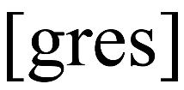
回課文
grace
n. [U] 優美；優雅
The large swan spread its wings with splendid grace and took off into the stunning sunset.
帶著華麗的優雅，那隻大天鵝展開翅膀，起飛並往極為美麗的落日飛去。

Slide 152
回衍生
grace n. [U] 優美；優雅
As a member of the royal family, the prince has grace and good manners.
字詞搭配
with (a) good/bad grace 有風度地／不情願地

Slide 153
回衍生
grace n. [U] 恩典
According to Christian beliefs, God shows his grace to all people, regardless of their race, gender, or occupation.
grace n. [U] 餐前感恩禱告
I grew up in a strict Catholic family. That’s why I developed the habit of saying grace before I eat.

Slide 154
回課文
15. appearance
n. [C] 外表 looks, visible features, or characteristics
The actress’s red hair and brown eyes give her a very distinctive appearance.
那位女演員紅色的頭髮以及棕色的眼睛給了她一個非常獨特的外表。

Slide 155
回主單
appearance n. [C] 外表
A person’s appearance often plays a crucial role in how people treat them.
appearance n. [C] 出現；到來
To the young fan’s surprise, her favorite singer made a sudden appearance and gave a performance at her birthday party.

Slide 156
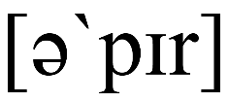
回課文
appear
vi. 出現
Dinosaurs first appeared on the earth around 240 million years ago. Snakes followed around 142 million years later.
恐龍約在兩億四千萬年前首次出現在地球上。蛇接著約在一億四千兩百萬年後出現。

Slide 157
回衍生
appear vi. 出現
The grizzly bear appeared out of nowhere and gave the mountain climbers the fright of their lives.
appear vi. 似乎；顯得
The driver appeared to be in distress, so the police stopped to check on him.

Slide 158
回衍生
文法
(1)用真主詞開頭，後接形容詞、名詞或名詞片語作為主詞補語。
Alex appears happier after breaking up with his girlfriend.
(2)用虛主詞it開頭，後接that引導的名詞子句。
It appears that no one really knows how to fly a drone.

Slide 159
回衍生
(3)用真主詞開頭，後接不定詞片語to + VR表示現狀，或是to + have p.p.來表示該動作或狀態比appear更早發生。
No one appeared to be at home when the mail carrier knocked on the door.
Barbara appears to have gone to bed very late last night.

Slide 160
回課文
16. instrument
n. [C] 樂器 a tool one uses to perform music
Can you play any musical instruments, such as the piano or the guitar?
你能彈奏任何樂器，像是鋼琴或吉他嗎？

Slide 161
回主單
instrument n. [C] 樂器
Common stringed instruments include the guitar, violin, viola, cello, and ukulele.
字詞搭配 (1) orchestral instrument 管弦樂器
(2) electronic instrument 電子樂器
(3) modern instrument 現代樂器
(4) classical instrument 古典樂器

Slide 162
回課文
16. instrument
n. [C] 工具；儀器
Scientists use very advanced measuring instruments to determine the weight of atoms.
科學家用非常先進的測量儀器來確認原子的重量。

Slide 163
回衍生
instrument n. [C] 工具；儀器
It is absolutely illegal for the police to use instruments of torture when questioning a suspect.

Slide 164
回List
回課文
instrumental
adj. 樂器的
Yvonne only listens to instrumental music when she studies because music with words tends to distract her.
Yvonne在讀書的時候只聽樂器演奏的音樂，因為有歌詞的音樂往往會使她分心。

Slide 165
回衍生
instrumental adj. 樂器的
The composer decided to make the movie soundtrack completely instrumental.
instrumental adj. 有幫助的；起關鍵作用的
The mayor was instrumental in getting his city a new sports center.

Slide 166
回課文
17. literature
n. [U] 文學；文學作品 written works such as novels, plays, and poems
Novels such as Dream of the Red Chamber and A Tale of Two Cities are very famous works of literature.
像是《紅樓夢》和《雙城記》的小說都是非常有名的文學作品。

Slide 167
回主單
literature n. [U] 文學；文學作品
Classical literature refers to the great masterpieces of ancient Greek and Roman civilizations.
In general, contemporary (現代) literature refers to works that were written after World War II.

Slide 168
回主單
literature n. [U] （某領域的）文獻
Although I made every effort to search for it, I could find very little literature on this topic.

Slide 169
回課文
literary
adj. 文學的；文藝的
Few people in the world would disagree that Shakespeare was one of the greatest literary masters of all time.
世界上很少人會不同意莎士比亞是有史以來最偉大的文學大師之一。

Slide 170
回衍生
literary adj. 文學的；文藝的
The first Nobel Prize in Literature was awarded in 1901, and it has become one of the world’s most desired literary prizes.
literate adj. 有讀寫能力的 反 illiterate
It is hard to believe that only twenty-five percent of the people in that country are literate.

Slide 171
回衍生
literal adj. 字面意義的
The meaning of an idiom is different from the literal meaning of its individual words. In other words, it does not mean exactly what the words say.
literal adj. 缺乏想像力的
I was disappointed with the cellist’s performance because his interpretations of Bach’s work were too literal.

Slide 172
回課文
18. deliberate
adj.（動作等）小心翼翼的 slow, precise, and careful
Zoo employees didn’t want to frighten the rhino, so they approached the animal with very slow, deliberate movements.
動物園的員工不想要嚇到那頭犀牛，所以他們用非常緩慢和小心翼翼的動作接近牠。

Slide 173
回主單
deliberate adj.（動作等）小心翼翼的
The mother approached her sleeping baby with slow, deliberate steps to avoid waking her up.
deliberate vi. 仔細考慮；深思熟慮；反覆思考
The judges spent a few hours deliberating on who would be crowned Miss Universe.

Slide 174
回課文
deliberate
adj. 有意的；故意的
Brian’s hurtful words had not been deliberate. He didn’t realize that you were sensitive about this topic.
Brian傷人的話並不是故意的。他並不知道你對這個話題很敏感。

Slide 175
回衍生
deliberate adj. 有意的；故意的 同 intentional
It was simply a mistake that Zack misspelled his girlfriend’s surname. It was certainly not deliberate.

Slide 176
回課文
19. destination
n. [C] 目的地 a final place of arrival
Bali, Indonesia has become one of the most popular holiday destinations for travel bloggers and Instagram influencers.
印尼的峇里島已經成為最受旅遊部落客和IG網紅歡迎的度假目的地之一。

Slide 177
回主單
destination n. [C] 目的地
The three most popular tourist destinations in 2019 were France, Spain, and America.

Slide 178
回課文
1. turn...into...
（把⋯⋯）變為⋯⋯ to change or transform into someone or something else
A bite from a strange spider turned Peter Parker into Spider-Man.
一隻奇特的蜘蛛咬了彼得．帕克一口，把他變成蜘蛛人。

Slide 179
回片語
turn...into... （把⋯⋯）變為⋯⋯
Margaret has a green thumb. She has turned the backyard into a beautiful small garden.

Slide 180
回課文
2. feast one’s eyes on
使人目不暇給；盡情欣賞
to look with delight or appreciation at something stunning, splendid, or magnificent
Emma took a leisurely walk through the flower market and feasted her eyes on all the splendid, colorful blossoms.
Emma悠閒地散步走過花市，盡情欣賞所有多彩多姿的美麗花朵。

Slide 181
回片語
feast one’s eyes on 使人目不暇給；盡情欣賞
The tourists walked along the Seine (塞納河), feasting their eyes on everything Paris had to offer.
延伸補充
feast on意為「盡情享受（美味佳餚）」，feast one’s eyes on則引申為「大飽眼福」之意。on後的受詞可為物或人。

Slide 182
回課文
3. face to face
面對面 very near to facing one another
Ronnie was stunned when he came face to face with his ex-girlfriend in the elevator. There was no escape!
Ronnie在電梯裡和他的前女友面對面碰上時非常震驚。他無處可逃。

Slide 183
回片語
face to face 面對面
To avoid any misunderstandings, you should try to talk to your girlfriend face to face.
文法
若詞性為副詞，可用face to face或是face-to-face，若詞性是形容詞，則只能用face-to-face，例如a face-to-face job interview。

Slide 184
回課文
4. stand out
顯眼 to be very distinctive or easy to recognize
Both sisters are over two meters tall, so they really stand out in a crowd. You’ll spot them from a mile off!
兩姐妹身高都超過兩公尺，所以她們在人群中非常顯眼。一英里外你就能看到她們。

Slide 185
回片語
stand out 顯眼
The ugly duckling stood out among the others because he looked very different.

Slide 186
回片語
延伸補充
stand out除了「顯眼」的意思外，也有「出色」的意思，例句如下：
Lauren stands out from the rest of the applicants for the job because she has ten years of experience in the field.

Slide 187
回課文
5. fall in love with
愛上 to begin to love or greatly admire someone or something, especially when it happens suddenly
When Mimi first read Jane Austen’s novels and Shakespeare’s plays, she fell in love with Western literature.
當Mimi第一次讀到珍．奧斯汀的小說和莎士比亞的戲劇時，她就愛上了西方文學。

Slide 188
回片語
fall in love with 愛上
When Romeo saw Juliet for the first time, he fell in love with her immediately.

Slide 189
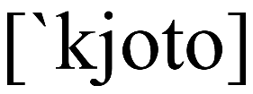
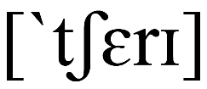
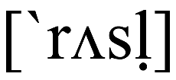
1. Kyoto n. 京都
回課文
2. kimono n. [C] 和服
回課文
3. cherry n. [C] 櫻桃；櫻桃樹
回課文
4. rustle vi. 沙沙作響
回課文

Slide 190
回識字
cherry n. [C] 櫻桃；櫻桃樹
The girls are picking cherries in the orchard.

Slide 191
回識字
rustle vi. 沙沙作響
The maple leaves are rustling gently in the autumn breeze.
rustle vt. 發出沙沙聲
James rustled the papers in his hands because he was nervous.

Slide 192
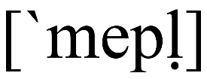
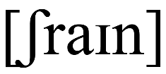
5. maple n. [C] 楓樹
回課文
6. landscape n. [C] usually sing. 景色；風景
回課文
7. shrine n. [C] 神社
回課文
8. Kinkaku-ji, Golden Pavilion Temple n. 金閣寺
回課文

Slide 193
回識字
maple n. [C] 楓樹
The maple tree has a very distinctive leaf, which is the symbol of Canada.
字詞搭配
maple syrup 楓糖漿

Slide 194
回識字
landscape n. [C] usually sing. 景色；風景
With its extremely dry landscape and extreme temperatures, this desert is almost uninhabitable（無法居住的）.

Slide 195
回識字
shrine n. [C] 神社
The fishermen prayed at their local shrine before heading out to the sea.

Slide 196
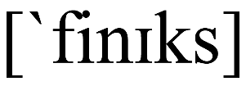
9. crystal-clear adj. 清澈的
回課文
10. bronze adj. 古銅色的
回課文
11. phoenix n. [C] 鳳凰
回課文
12. shimmering adj. 閃閃發光的
回課文

Slide 197
回識字
shimmering adj. 閃閃發光的
The morning sun slowly rose over the shimmering lake, creating a beautiful reflection on the water.

Slide 198
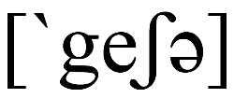
13. geisha n. [C] 藝妓
回課文
14. lipstick n. [U] 口紅
回課文
15. hairpin n. [C] 髮簪；髮夾
回課文
16. kyomai n. 京舞
回課文
17. must-see n. 必須參觀的
回課文

Slide 199
回識字
must-see adj. 必須參觀的
The museum has the largest collection of paintings in the world, making it a must-see destination for art lovers.

Slide 201
Longteng • Follow Neihu, Taipei City
THIEF CAUGHT ON CAMERA:
A man was seen breaking into a
car last night in Neihu.
Fanny23 Horrible!
James The guy looks familiar.
Will @James U know him?
在此語境中，一名男子被監視器拍到正在敲破車窗行竊。為了表達某人被目擊在做某事，因此使用「be seen + V-ing」的句型。

Slide 202
回語境漫畫
此句型為感官動詞的被動語態，直譯為「某人被看到或聽到在做某事」，但在中文中可譯為「有人看到或聽到某人在⋯⋯」較為自然。當「看到」或「聽到」的動作施作者不明或非主要訊息時即可使用此句型。教師可提供學生以下兩句話，箭頭左邊的句子是自然的中文語句，右邊則為譯成英文後的語序。
有人看到那名男子在便利商店前抽菸。→那名男子被看到在便利商店前 抽菸。
（誰？施作者不明）

Slide 203
 | be seen/heard + V-ing/to VR
1. 此句型為感官動詞 see 及 hear 的被動語態。當「看到」或「聽到」的動作施作者不明或不重要時，會使用被動語態。
Several dogs were heard barking outside.
2. 感官動詞「be seen/heard」後面接不定詞，表達做某事的完整過程都被看到或聽到。
Ann was seen to steal the Hello Kitty doll from the shop. （偷竊的整個過程都被看到。）

Slide 204
 | be seen/heard + V-ing/to VR
3. 感官動詞「be seen/heard」後面接現在分詞，表達做某事的當下被人看到或聽到。
Ann was seen stealing the Hello Kitty doll from the shop. （偷竊時正巧被人撞見。）
In summer, green leaves can be heard rustling in the wind and seen sparkling in the sunshine. (line 4)

Slide 205
回句型
 | be seen/heard + V-ing/to VR
當課句型
1. 此句型為感官動詞see及hear的被動語態。當「看到」或「聽到」的動作施作者不明或不重要時，會使用被動語態。
Johnson was seen dancing/to dance behind the curtain.
2. 感官動詞「be seen/heard」後面接不定詞，表達做某事的完整過程都被看到或聽到。
Someone was heard to scream for help in the park.

Slide 206
回句型
 | be seen/heard + V-ing/to VR
3. 感官動詞「be seen/heard」後面接現在分詞，表達做某事的當下被人看到或聽到。
Cathy was heard crying in the restroom.

Slide 207
回句型
 | be seen/heard + V-ing/to VR
1. 在複習完感官動詞的主動用法後，可將以下兩句寫在黑板上並討論兩句的不同。可觀察兩點：(1)為何要將A句改成B句？(2)B句的結構是什麼？透過提問與歸納，引導學生理解感官 動詞被動態的使用時機及結構。 (A) Someone saw an old lady hit the dog. ↓ (B) An old lady was seen to hit the dog.

Slide 208
回句型
 | be seen/heard + V-ing/to VR
參考解說： (1) 因為A句的動作施作者不明，故可使用感官動詞的被動 語態改寫句子。 (2) B句的結構為S + be seen + to VR....。

Slide 209
回句型
 | be seen/heard + V-ing/to VR
2. 接著，可討論以下C、D兩句之語意有何不同，並參考課本中的例句與說明，熟習感官動詞使用於被動的語法結構及語意差異。 (C) David was heard to sing a romantic song to his lover. (D) David was heard singing a romantic song to his lover.

Slide 210
回句型
 | be seen/heard + V-ing/to VR
參考解說： C句：有人聽到David唱情歌給他的情人聽，而且從頭聽到尾， 把整首歌都聽完。 D句：有人正巧聽到David唱情歌給他的情人聽，而且可能是在 David唱到一半時才聽到，並沒有聽到David唱整首歌。

Slide 211
回句型
 | be seen/heard + V-ing/to VR
額外補充
若感官動詞後的受詞與受詞補語的關係為被動，則受詞須用過去分詞。若要強調受詞補語的動作正在進行，則可在過去分詞前加上being。老師可斟酌學生程度，決定是否補充此句型。
see/hear/notice... + O +
p.p.
being p.p.
（強調動作發生的當下）

Slide 212
回句型
 | be seen/heard + V-ing/to VR
Denny saw the boy brutally beaten but didn’t give him a helping hand.
Denny saw the boy being brutally beaten but no one gave him a helping hand.

Slide 213
 | be seen/heard + V-ing/to VR
Rewrite the following sentences using the above pattern. The first one has been done for you.
1. John fell over flat on his back. Someone saw it.
→ John was seen to fall over flat on his back.
2. A baby was crying in the house. Some people heard it.
→ .
A baby was heard crying in the house.

Slide 214
 | be seen/heard + V-ing/to VR
Rewrite the following sentences using the above pattern. The first one has been done for you.
3. The engine made a strange noise. Somebody heard it.
→ .
4. A fat bald man was sneaking in through the back door. Someone saw him.
→ .
The engine was heard to make a strange noise.
A fat bald man was seen sneaking in through the back door.

Slide 215
 | be seen/heard + V-ing/to VR
Rewrite the following sentences using the above pattern. The first one has been done for you.
5. The old man did one hundred push-ups without taking a break. People saw this.
→ . .
The old man was seen to do one hundred push-ups without taking a break.

Slide 216
 | be seen/heard + V-ing/to VR
Rewrite the following sentences using the above pattern. The first one has been done for you.
6. The missing boy was playing on a swing in the park this morning. Someone saw him there.
→ . .
The missing boy was seen playing on a swing in the park this morning.

Slide 217
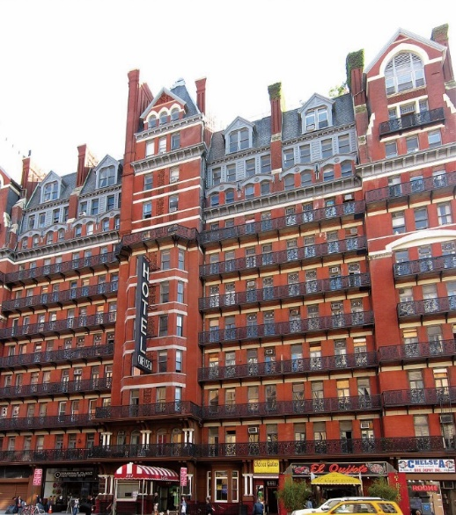
 | be seen/heard + V-ing/to VR
New York’s Hotel Chelsea is one of the most famous haunted* hotels in America. Complete the following sentences that show what people have seen and heard during their stay at Hotel Chelsea using the pattern above and the words in the box. The first one has been done for you. Which one do you think is the scariest?
Word Bank
haunted 鬧鬼的

Slide 218
 | be seen/heard + V-ing/to VR
題目 1~2
3
4~5
6
A. a woman / hear / sob / loudly / in the bathroom / in the dead of night
B. one chair / see / rock back and forth / on its own
C. a little boy / see / open the fridge / take out a pudding / and disappear into thin air
D. a girl dressed in red / see / stand / at the foot of the bed
E. some kids / hear / giggle and whisper / some unknown words
F. hundreds of soldiers / hear / march and chant* / in the hallway
Word Bank
chant 吟唱

Slide 219
 | be seen/heard + V-ing/to VR
選項
1. A woman was heard sobbing loudly in the bathroom in the dead of night. She was believed to have been murdered in that bathroom.
2. . . She just stood there staring at people when they were asleep.
A girl dressed in red was seen standing/to stand at the foot of the bed.

Slide 220
 | be seen/heard + V-ing/to VR
選項
Hundreds of soldiers were heard marching and chanting/to march and chant in the hallway.
3. . . They were rumored to have been buried under the ground of the hotel.

Slide 221
 | be seen/heard + V-ing/to VR
選項
One chair was seen rocking/to rock back and forth on its own.
4. . It then moved across the floor and crashed into the mirror with a big bang.
5. . . They stopped laughing and talking when people woke up.
Some kids were heard giggling and whispering/to giggle and whisper some unknown words.

Slide 222
 | be seen/heard + V-ing/to VR
選項
A little boy was seen to open the fridge, take out a pudding, and disappear into thin air.
6. . . No one knew how the boy got into and out of the room.
亦可寫為：A little boy was seen opening the fridge, taking out a pudding, and disappearing into thin air.

Slide 223
回句型練習
 | be seen/heard + V-ing/to VR
補充練習
補充練習
A. 將下列各句改寫為被動語態
1. Someone saw the young bird falling out of the nest.
→ The young bird was .
2. Someone saw a man in black unlock the door and enter the building. → A man in black was . .
seen falling out of the nest
seen to unlock the door
and enter the building

Slide 224
回句型練習
 | be seen/heard + V-ing/to VR
補充練習
補充練習
A. 將下列各句改寫為被動語態
3. Someone heard some kids playing hide-and-seek in the park.
→ Some kids were .
heard playing hide-and-seek in the park

Slide 225
回句型練習
 | be seen/heard + V-ing/to VR
補充練習
補充練習
A. 將下列各句改寫為被動語態
4. Someone saw Louis leaving the crime scene right after the explosion happened.
→ Louis was . ..
seen leaving the crime scene right after the explosion happened

Slide 226
回句型練習
 | be seen/heard + V-ing/to VR
補充練習
A. 將下列各句改寫為被動語態
5. Someone saw the taxi stop in front of the 7-ELEVEN and then drive away.
→ The taxi was . .
seen to stop in front of the 7-ELEVEN and then drive away

Slide 227
回句型練習
 | be seen/heard + V-ing/to VR
補充練習
補充練習
B. 引導式翻譯
1. 有人聽到灌木叢裡（bush）有獅子吼叫的聲音。 A lion was .
2. 有人看到那個小孩在花園裡跟一隻狗玩。 The child was .
heard roaring/to roar in the bush
seen playing/to play with a dog in the garden

Slide 228
回句型練習
 | be seen/heard + V-ing/to VR
補充練習
補充練習
B. 引導式翻譯
3. 有人看到一名可疑男子在辦公大樓外面遊蕩（wander）。 A suspicious-looking man was . .
4. 有人看到那隻狗在追趕一名男子。 The dog was .
seen wandering/to wander outside the office building
seen chasing/to chase a man

Slide 229
回句型練習
 | be seen/heard + V-ing/to VR
補充練習
補充練習
B. 引導式翻譯
5. 我們看到那名男子被一隻狗追。 We saw the man .
(being) chased by a dog

Slide 231
Don’t worry about her. She has watched this Korean drama more than ten times, but still, she never watches it without crying.
What’s wrong with your mom?

Slide 232
回語境漫畫
在此語境中，左邊女孩看見右邊女孩的母親在哭，因此問她她母親怎麼了，右邊女孩回答她：「不用擔心。她看這齣韓劇超過十次了，但還是每看必哭」。右邊女孩為了強調她母親「每看必哭」的情況， 因此使用never...without...雙重否定的句型。

Slide 233
回語境漫畫
雙重否定類似數學中「負負得正」的概念，用來表達肯定的語意。說話者使用雙重否定而不直接使用肯定句構的目的通常有二：
1. 用以強化語氣（本課例句皆為此語用功能） 此類的雙重否定通常會在否定詞no/not/never後面搭配without，用來強調without後面所接的人、物或動作為關鍵因素，表達「若沒有這項因素就不⋯⋯」的語意。例如下句，his camera是關鍵物品，若James沒有帶上這個關鍵物品就不出門。

Slide 234
回語境漫畫
James is a photography lover. He never goes out without his camera. (= James’s camera is very important to him. It is impossible that James would go out without bringing it. In other words, whenever you see James, he is sure to have his camera with him.)
2. 用於弱化語氣 此類的雙重否定是為了避免做出太過武斷或冒犯人的評論，讓語氣較為委婉（This structure is used as a way of softening or downplaying a statement, which can be useful when a touch of diplomacy or subtlety is required.）。

Slide 235
回語境漫畫
形成方式通常都是將一個形容詞改寫成「not + 否定字首 + 形容詞／副詞」，如：common→not uncommon, significant→not insignificant, responsible→not irresponsible, reasonably→not unreasonably。雖然此句構非常常見但因非本課焦點，老師可視學生程度補充。若時間允許，老師可給學生以下A、B兩句讓學生討論兩句語意的不同。 (A) The results are conclusive. (B) The results are not inconclusive.

Slide 236
回語境漫畫
參考解說： A句： A句表示「該結論是確鑿或無庸置疑的」，語氣直接而有 把握。 B句： B句的說話者不想做出太過武斷的陳述，亦暗示著該結果 仍有些許討論的空間。

Slide 237
Read the first two sentences carefully and mark the last four sentences in the same way. Also, complete the conclusion below.
1. James is a photography lover. He never goes out without his camera.
2. No trip to Japan is complete without a visit to Mt. Fuji.
3. The little girl does not feel secure without her mother by her side.
4. Do not go outside without a coat, or you’ll catch a cold.

Slide 238
Read the first two sentences carefully and mark the last four sentences in the same way. Also, complete the conclusion below.
As the saying goes, “You can’t make an omelet without breaking eggs.”
There is no rule without exceptions.

Slide 239
Each of the sentences above has two . They are used together to reinforce a statement.
□ opposite words □ negative words
No visit to Kyoto would be complete without seeing one of the most photographed landmarks: the Kinkaku-ji, or the Golden Pavilion Temple in English. (line 12)
Of course, no “person of art” could be a true geisha without being able to perform the traditional kyomai dance. (line 34)

Slide 240
Step 1: Form groups of six. Brainstorm about what behavior is not allowed in your class. Work with your group members to establish a set of rules for the whole class to follow using “no/never/not...without....”
Step 2: Create a poster and share it with your classmates.

Slide 241
Our Class Rules
1. Never take a sick leave without informing your teacher. .
2. .
3. .
4. .
5. .
6. .
Do not go to the toilet without telling the teacher.
Never eat your lunch without washing your hands first.
Never leave the classroom without having heard the bell ring.
Don’t hand in homework late without a proper reason.
Don’t chat with your classmates without the teacher’s permission.

Slide 242
回語用活動
1. 活動目的： 本活動旨在了解no/never/not...without...的語用功能並活用於真實的生活情境當中。

Slide 243
回語用活動
2. 步驟中譯：
步驟一：六人一組。集思廣益有哪些行為在你的班上是被禁止的。與小組成員合作並制訂一系列讓全班遵守的班級生活公約，且必須以no/never/not...without...的句型來撰寫。
步驟二：將生活公約寫在海報上並發表給全班同學聽。

Slide 244
回語用活動
3. 活動操作建議：
(1) 各組發表時，可提問「Why do you think this rule is important? 」或「Why did you make this rule? 」，了解想法。
(2) 各組發表後，可圈選出重疊性最高的前2~3則，再票選出另外3~4則，作為班級生活公約。

Slide 245
回語用練習
A. 用no/not/never...without...改寫以下各句
1. Sophia always washes her hands before she eats.
→ Sophia eats her hands.
2. Every time I watch a movie, I eat popcorn.
→ I watch a movie popcorn.
never
without
washing
never
without
eating

Slide 246
回語用練習
A. 用no/not/never...without...改寫以下各句
You must have a password to get access to this account.
→ You cannot . .
Tony always thinks twice before he makes an important decision.
→ Tony never . .
get access to this account without having a
password
makes an important decision without thinking
twice

Slide 247
回語用練習
A. 用no/not/never...without...改寫以下各句
5. Before Cecilia starts her work, she always makes a plan in advance.
→ Cecilia . .
does not start/never starts her work without making a plan in advance

Slide 248
回語用練習
B. 整句式翻譯
1. 沒有我媽媽的允許我不能出門。（...not...without...） . .
2. 一個團隊沒有合作是不能贏得比賽的。（...not...without...） .
I cannot/am not allowed to go out without my mother’s permission/approval.
A team cannot win a game without cooperation.

Slide 249
回語用練習
B. 整句式翻譯
3. Jessica每次去百貨公司都會買衣服。（...never...without...） . .
4. 有些學生每次考試都會感到緊張。（... never...without...） .
Jessica never goes to a department store without buying clothes.
Some students never take an exam without feeling nervous.

Slide 250
回語用練習
B. 整句式翻譯
沒有參觀過艾非爾鐵塔（the Eiffel Tower）巴黎之旅就不算 完整。（No...without....） .
No trip to Paris is complete without a visit to the Eiffel Tower.

Slide 252
Fill in the blanks with the correct words.
philosophers | meditation | path | souvenir
When I need some inspiration, I always take a walk along the in the park near my house.
It is said that doing every day can relieve your anxiety.
path
meditation

Slide 253
Fill in the blanks with the correct words.
philosophers | meditation | path | souvenir
philosophers
Socrates is undoubtedly one of the greatest . of all time.
I bought this set of nesting dolls as a on my trip to Russia last year.
souvenir

Slide 254
Listening for Locations and Directions
Locations and directions are key information that you need to listen carefully for. Locations indicate a particular place, especially in relation to other areas, buildings, etc. Directions point out the proper route from one place to another. Signal words and phrases may include north, south, east, west, up, down, left, right, forward, backward, ahead, etc.

Slide 255
Listen to the conversation. What is it probably about?
(A) An introduction to the famous temples of Kyoto and how to visit them.
(B) An interview with a Japanese director about his new film Cherry Blossoms.
(C) A dialogue between a tour guide in Kyoto and someone taking his tour.
C

Slide 256
回聽力策略
Tour guide: Is everyone here? Let’s see...28, 29, 30. Yes, that’s everyone! I hope you enjoyed our tour of Ginkaku-ji ¹Temple. Next, we are going to walk south along a lovely pathway called the ²Philosopher’s Walk, which stretches between Ginkaku-ji Temple and Nanzen-ji Temple neighborhood. The walk starts just a little to the west of here; it will take us about five minutes to get to the entrance.
Tour member: Excuse me. Why is it called the Philosopher’s Walk?
Notes:
聽力腳本音檔可跨投影片播放。無音檔控制條，若欲停止音檔播放，請將投影片回到上一頁或回到聽力策略。若要暫停音檔播放可按滑鼠右鍵；欲繼續播放再按一下滑鼠左鍵。

Slide 257
回聽力策略
Tour guide: It has this name because of a famous Kyoto University ³professor, Nishida Kitaro, who used to practice ⁴meditation on this ⁵path on his daily journey to the university, which is also west of here.
Tour member: How long does it take to walk the whole path?
Tour guide: The Philosopher’s Walk is less than two kilometers long and can be walked in 30 minutes, but we don’t need to hurry. There is some really beautiful scenery along this stone pathway!
Notes:
聽力腳本音檔可跨投影片播放。無音檔控制條，若欲停止音檔播放，請將投影片回到上一頁或回到聽力策略。若要暫停音檔播放可按滑鼠右鍵；欲繼續播放再按一下滑鼠左鍵。

Slide 258
回聽力策略
Tour member: What can we ⁶expect to see on the way?
Tour guide: Well, first, you are lucky that you are visiting in spring. If you look up, you will ⁷notice that the cherry trees are in full ⁸bloom. Don’t miss the ⁹opportunity to take some lovely photos! Next, you can also visit several temples and shrines, including the famous Honen-in Temple, which you will see on your left after about 5 minutes of walking. You will also come across some cafés where you can stop for a drink on your journey, and if you need some ¹⁰souvenirs,
Notes:
聽力腳本音檔可跨投影片播放。無音檔控制條，若欲停止音檔播放，請將投影片回到上一頁或回到聽力策略。若要暫停音檔播放可按滑鼠右鍵；欲繼續播放再按一下滑鼠左鍵。

Slide 259
回聽力策略
there are some small shops as well. The Philosopher’s Walk
ends just north of the Nanzen-ji Temple neighborhood. On the western side of the neighborhood is the Tofu Restaurant, where we’ll meet at noon for lunch. Okay, we have now reached the start of the Philosopher’s Walk. See you in 50
minutes at the restaurant! If you have any trouble, just call me on my cellphone.
Notes:
聽力腳本音檔可跨投影片播放。無音檔控制條，若欲停止音檔播放，請將投影片回到上一頁或回到聽力策略。若要暫停音檔播放可按滑鼠右鍵；欲繼續播放再按一下滑鼠左鍵。

Slide 260
回聽力腳本
導 遊：每個人都在嗎？讓我們來看看⋯⋯28、29、30。是的，每個人都在！希望您喜歡我們的銀閣寺之旅。接下來，我們將沿著一條名為「哲學之道」的美麗小徑往南走，它綿延於銀閣寺與南禪寺鄰近地區之間。小徑的起始點大約位於這裡的西邊一點點；到那裡的入口處大約需要五分鐘。
遊覽成員：對不起。為什麼將其稱為「哲學之道」？

Slide 261
回聽力腳本
導 遊：因為京都大學著名教授西田幾多郎而得名，他以前經常在這條他每日通往大學的小徑上冥想，京都大學也在這裡的西邊。
導遊成員：走完整條路要花多長時間？
導 遊：哲學之道不到兩公里長，可以在30分鐘內走完，但我們不必著急。前面的這條石路上有一些非常美麗的風景！

Slide 262
回聽力腳本
遊覽成員：在這條路上，我們可以期望看到什麼呢？
導 遊：好吧，您很幸運您是在春天來訪。如果您向上看，您會發現櫻花盛開。不要錯過拍攝一些可愛照片的機會！接著，您也可以參觀幾座寺廟和神社，包括著名的法然院，您會在走了約5分鐘後於您的左邊看到。您也會發現一些咖啡館，可以在路途中停下腳步喝杯咖啡，而且如果您需要一些紀念品，

Slide 263
回聽力腳本
那麼也有一些小商店。哲學之道約結束於南禪寺鄰近地區的北邊。在鄰近地區的西方是豆腐餐廳，我們中午要在那裡見面並享用午餐。好的， 我們現在抵達哲學之道的起始點了。50分鐘後在餐廳見！如果您有任何麻煩，請用手機打電話給我。

Slide 264
回聽力腳本
1. temple n. [C] 寺院；寺廟
2. philosopher n. [C] 哲學家
3. professor n. [C] 教授
4. meditation n. [U] 沉思；冥想
5. path n. [C] 小徑；小路
6. expect vi. 預期
7. notice vt. 注意；注意到
8. bloom n. [U] 開花；開花期
9. opportunity n. [C] 機會；良機
10. souvenir n. [C] 紀念品； 紀念物

Slide 265
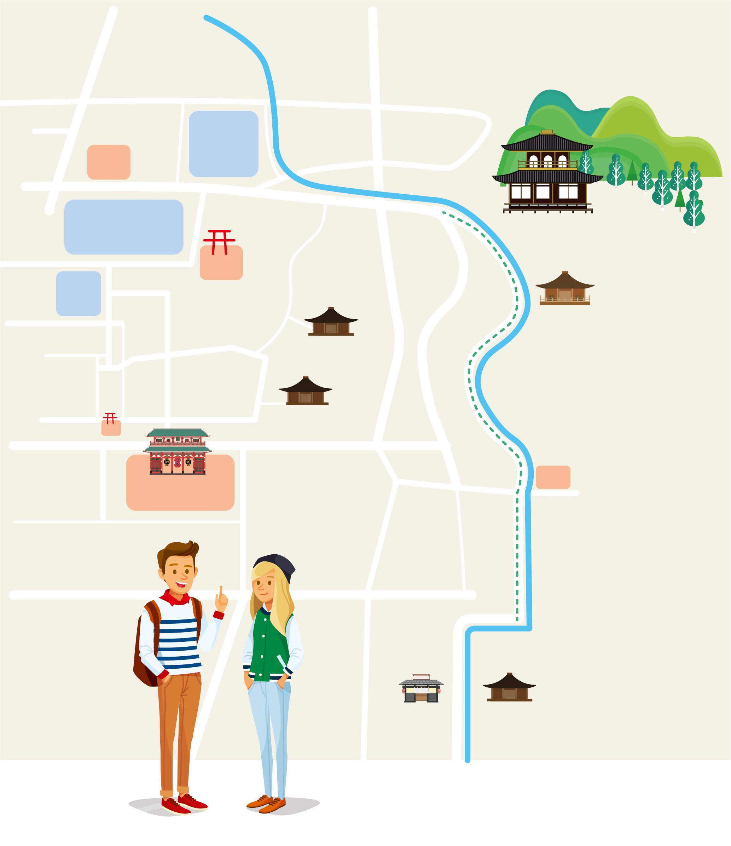
Listen again and mark the following spots on the map.
A. Ginkaku-ji Temple
B. Honen-in Temple
C. Philosopher’s Walk
D. Nanzen-ji Temple
E. Tofu Restaurant
A
The tourists
are now here.
B
C
E
D

Slide 266
寫
作手冊

Slide 267
Describing a Person in Your Class
You are going to describe a person in your class. Begin with a physical description, followed by a description of that person’s personality and behavior. When you are finished, read your summary to the class, and then ask them to guess who was described.

Slide 268
回寫作手冊
寫作任務說明
本課寫作任務是要針對班上一個人（老師或同學），寫出一篇120－150字的描寫文。第一冊曾運用空間順序，介紹家裡的一個空間。若之前已做過練習，可先複習之前學過的內容。若這是第一次書寫描寫文，則可先以此練習為主，第一冊的內容為輔，額外多做練習。
本課實際運用從課文中學到的「描述順序」與「感官細節」，針對一個同學的外表打扮與內在性格進行描述，

Slide 269
回寫作手冊
其中的外表打扮又可細分為從頭上一路到腳下，全身上下的特點與裝扮，可利用架構圖整理出跟這個人有關的細節，再寫成一篇描寫文。
2－3人一組，一起發想與討論，每組描寫班上的一個人。最後可讓同學朗讀自己的文章，讓其他人猜猜看文章的主角是誰。

Slide 270
Model
The following is Ruby’s description about her best friend in the class—Mia. Read about what Mia looks like and what kind of girl she is.
This person has straight black hair and an oval face. When she smiles, you can see dimples on her cheeks. She doesn’t wear glasses. She is tall and slender. She likes to swim and play sports very much, so she looks fit. She is left-handed, so she wears her smartwatch, which her father bought her as a birthday gift last year, on her right wrist.

Slide 271
Model
The following is Ruby’s description about her best friend in the class—Mia. Read about what Mia looks like and what kind of girl she is.
Humorous and easygoing, she can always make people laugh and attract others’ attention. She often says “a-ha” without realizing it, which amuses me a lot whenever I hear it. There are no jokes she doesn’t know. Every time I feel depressed, I go to her and she can always make me laugh.

Slide 272
回寫作手冊
Ruby描寫了她在班上最要好的朋友─Mia的長相與性格。除了讓學生閱讀範文，了解何謂描寫文，還可以利用寫作任務的空間圖，在黑板上整理Mia的相貌與個性。
Outside | Head | (hairstyle): straight black hair (face shape): an oval face, dimples on her cheeks (height & body type): tall and slender, look fit (special features): left-handed

Slide 273
回寫作手冊
Outside | Toes | (clothing): X (way of walking): X (others): X (accessories): wear no glasses, a smartwatch on her right wrist
Inside |  | (personality): humorous and easygoing (pet phrase): “a-ha” (hobby): like to swim and play sports (others): X

Slide 274
Plan
Step 1: Choose a person in your class that you would like to describe.
Step 2: Use the graphic organizer as a model to write down details about that person’s appearance (outside) and personality (inside).
Step 3: Make sure that you describe that person in a logical order, that is, from outside to inside and from head to toes.

Slide 275
回寫作手冊
1. 請決定要描寫班上哪一個人。
2. 請整理出人物的長相與性格，寫在G.O.裡面。
3. 提醒時態的變化。
4. 補充相關的感官細節。

Slide 276
回寫作手冊
Hairstyle
Hair type | Hair length | Hair color
straight (直髮)、wavy (波浪狀)、curly (捲髮)、spiky (刺蝟狀)、braided (髮辮)、ponytail (單馬尾)、pigtails (雙馬尾)、crew cut (平頭) | long (長髮) short (短髮) bald (光頭) shoulder-length (髮及肩) | dark brown (深褐色) light brown (淺褐色) blonde (金色)

Slide 277
回寫作手冊
Face Shape
oval (橢圓形、鵝蛋臉) square (方形) round (圓形) rectangle (正方形) long (長形) diamond (瓜子臉) heart-shaped (心形) triangle (三角形)
dimple (酒窩) smile lines (法令紋) freckle (雀斑) crow’s feet (魚尾紋) wrinkle (皺紋) forehead wrinkles (抬頭紋)

Slide 278
回寫作手冊
Height & Body Type
skinny (瘦削的) overweight (過重的) slim (苗條的) beefy (魁武健壯的) lanky (瘦長的) petite (嬌小的) plump (豐滿的) medium height (中等高度)
Way of Walking
walk briskly/swiftly (輕快地走路) stride confidently (昂首闊步) tiptoe (墊起腳尖走路) | heavy/light steps (腳步重／輕) wander aimlessly (四處閒晃) stumble (被絆倒)

Slide 279
回寫作手冊
Personality
adventurous (冒險的)、 ambitious (有野心的) athletic (熱愛運動的)、 brave (勇敢的) calm (冷靜的)、 dedicated (專心投入的)) | emotional (情緒化的)、 flexible (有彈性的) generous (慷慨的)、 helpful (熱心助人的) spontaneous (自動自發的)、 elated (興高采烈的)
5. 請檢視寫下的三個面向。

Slide 280
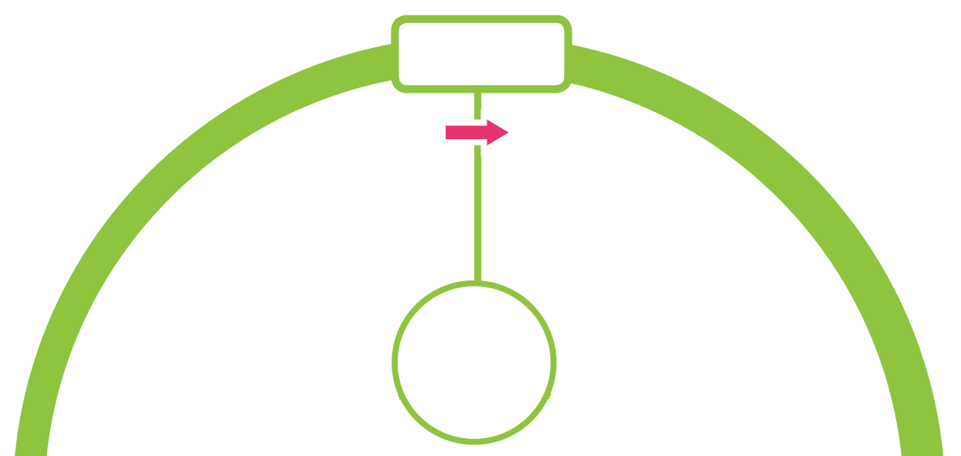
Outside
Head
Toes
．(hairstyle) has...hair
．(clothing) wears...
．(face shape) has a(n)...face
．(accessories) has/wears...on face/neck/wrist...
Name: .

Slide 281
Outside
Head
Toes
．(way of walking) ...when walking
．(height & body type) is/looks...
．(others)
．(special features) has...on face/arm/leg/any body parts...
Name: .

Slide 282
．(personality) is a(n)...person
．(pet phrase) often says...without realizing it
．(hobby) likes to...
．(others)
Inside
Write
Now, use the above information to write a description of a person in your class.

Slide 283
補
充資源

Slide 284
京都旅遊指南與文化遺產介紹
京都著名旅遊景點介紹
京都金閣寺的介紹
京都藝妓你應該要知道的七件事情
京都的龍安寺與方丈庭園
日本茶道的基本知識與體驗方法

Slide 285
1. Top 5 Things to do in Kyoto (07:32) 介紹在京都必做的五件事。
2. Top 10 Travel Attractions, Kyoto (Japan) - Travel Guide (02:05) 介紹京都必去的十個旅遊景點。
3. Kyoto Travel Guide JP | Travel better in JAPAN! (09:03) 介紹京都的旅遊規劃與景點。
4. Ultimate Golden Pavilion (Kinkakuji) Guide (04:10) 介紹金閣寺，包含其地點、景觀與建築構造。
5. The Secret World Of Geishas (02:33) 簡介藝妓的歷史演變與身分特色。

Slide 286
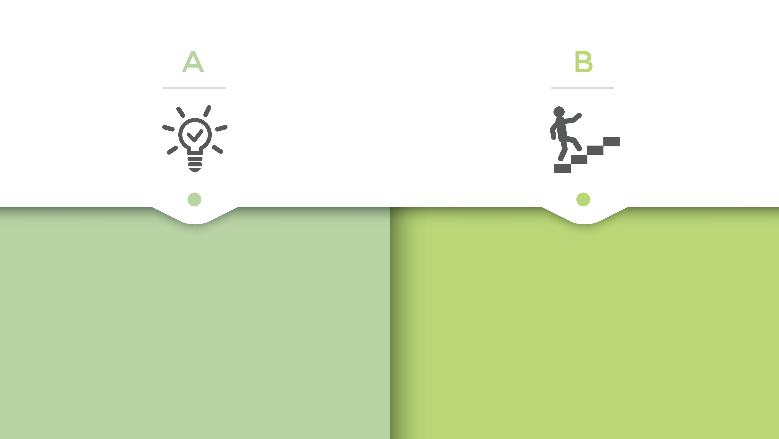
學習單(學用)
學習單(學用)
教用

Slide 287
圖
片來源
p. 221 切爾西旅館圖。Wikipedia提供。https://ltn.tw/T56TokZ
插圖來源：Shutterstock
影
片出處
Japanesquest < 10 Best Places to Visit in Kyoto! > https://www.youtube.com/watch/Od6IoKKriXo

